Slide 1
Structured Query Language
From A to Z

Slide 2
Capabilities of SQL SELECT Statements
Projection
Selection
Table 1
Table 1
Join
Table 1
Table 2
Notes:
Capabilities of SQL SELECT Statements
A SELECT statement retrieves information from the database. Using a SELECT statement, you can do the following:
Projection: You can use the projection capability in SQL to choose the columns in a table that you want returned by your query. You can choose as few or as many columns of the table as you require.
Selection: You can use the selection capability in SQL to choose the rows in a table that you want returned by a query. You can use various criteria to restrict the rows that you see.
Joining: You can use the join capability in SQL to bring together data that is stored in different tables by creating a link between them. You learn more about joins in a later lesson.
Instructor Note
Inform students that selection and projection are often considered horizontal and vertical partitioning.

Slide 3
Basic SELECT Statement
SELECT *|{[DISTINCT] column|expression [alias],...}
FROM table;
SELECT identifies what columns
FROM identifies which table
Notes:
Basic SELECT Statement
In its simplest form, a SELECT statement must include the following:
A SELECT clause, which specifies the columns to be displayed
A FROM clause, which specifies the table containing the columns listed in the SELECT clause
In the syntax:
SELECT is a list of one or more columns
* selects all columns
DISTINCT suppresses duplicates
column|expression selects the named column or the expression
alias gives selected columns different headings
FROM table specifies the table containing the columns
Note: Throughout this course, the words keyword, clause, and statement are used as follows.
A keyword refers to an individual SQL element.
For example, SELECT and FROM are keywords.
A clause is a part of a SQL statement.
For example, SELECT employee_id, last_name, ... is a clause.
A statement is a combination of two or more clauses.
For example, SELECT * FROM employees is a SQL statement.

Slide 4
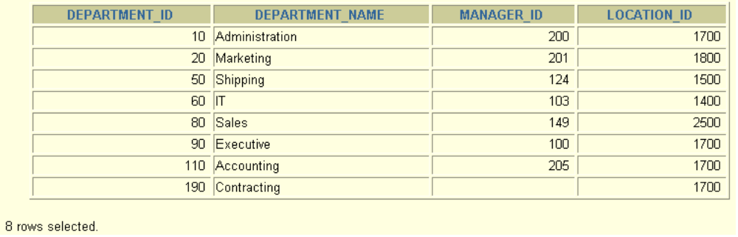
Selecting All Columns
SELECT *
FROM departments;
Notes:
Selecting All Columns of All Rows
You can display all columns of data in a table by following the SELECT keyword with an asterisk (*). In the example on the slide, the department table contains four columns: DEPARTMENT_ID, DEPARTMENT_NAME, MANAGER_ID, and LOCATION_ID. The table contains seven rows, one for each department.
You can also display all columns in the table by listing all the columns after the SELECT keyword. For example, the following SQL statement, like the example on the slide, displays all columns and all rows of the DEPARTMENTS table:
SELECT department_id, department_name, manager_id, location_id
FROM departments;
Instructor Note
Let the students know that details of all the tables are given in Appendix B.

Slide 5
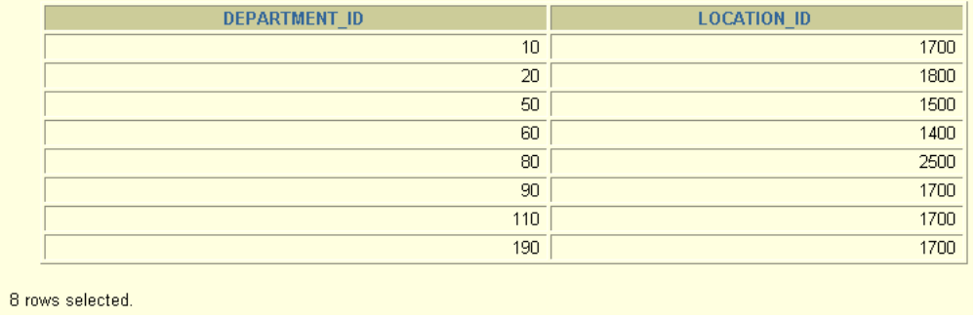
Selecting Specific Columns
SELECT department_id, location_id
FROM departments;
Notes:
Selecting Specific Columns of All Rows
You can use the SELECT statement to display specific columns of the table by specifying the column names, separated by commas. The example on the slide displays all the department numbers and location numbers from the DEPARTMENTS table.
In the SELECT clause, specify the columns that you want, in the order in which you want them to appear in the output. For example, to display location before department number going from left to right, you use the following statement:
SELECT location_id, department_id
FROM departments;
Instructor Note
You can also select from pseudocolumns. A pseudocolumn behaves like a table column but is not actually stored in the table. You cannot insert or delete values of the pseudocolumns. Some available pseudocolumns are CURRVAL, NEXTVAL, LEVEL, ROWID, and ROWNUM.

Slide 6
Writing SQL Statements
SQL statements are not case sensitive.
SQL statements can be on one or more lines.
Keywords cannot be abbreviated or split
across lines.
Clauses are usually placed on separate lines.
Indents are used to enhance readability.
Notes:
Writing SQL Statements
Using the following simple rules and guidelines, you can construct valid statements that are both easy to read and easy to edit:
• SQL statements are not case sensitive, unless indicated.
SQL statements can be entered on one or many lines.
• Keywords cannot be split across lines or abbreviated.
Clauses are usually placed on separate lines for readability and ease of editing.
• Indents should be used to make code more readable.
Keywords typically are entered in uppercase; all other words, such as table names and columns, are entered in lowercase.
Executing SQL Statements
Using iSQL*Plus, click the Execute button to run the command or commands in the editing window.
Instructor Note
Although not required in iSQL*Plus, placing a semicolon (;) at the end of the last clause is recommended. Other environments, such as PL/SQL programs, require that the end of each statement contains a semicolon.

Slide 7
Arithmetic Expressions
Create expressions with number and date data by using arithmetic operators.
Operator
+
-
*
/
Description
Add
Subtract
Multiply
Divide
Notes:
Arithmetic Expressions
You may need to modify the way in which data is displayed, perform calculations, or look at what-if scenarios. These are all possible using arithmetic expressions. An arithmetic expression can contain column names, constant numeric values, and the arithmetic operators.
Arithmetic Operators
The slide lists the arithmetic operators available in SQL. You can use arithmetic operators in any clause of a SQL statement except in the FROM clause.
Instructor Note
You can use the addition and subtraction operators only with DATE and TIMESTAMP data types.

Slide 8
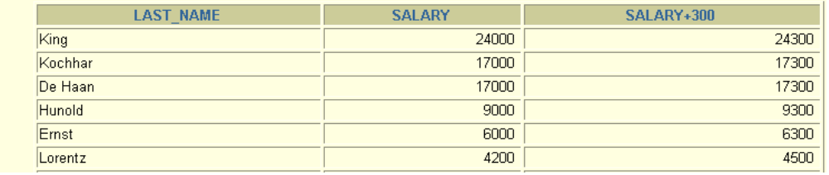
Using Arithmetic Operators
SELECT last_name, salary, salary + 300
FROM employees;
Notes:
Using Arithmetic Operators
The example in the slide uses the addition operator to calculate a salary increase of $300 for all employees and displays a new SALARY+300 column in the output.
Note that the resultant calculated column SALARY+300 is not a new column in the EMPLOYEES table; it is for display only. By default, the name of a new column comes from the calculation that generated it—in this case, salary+300.
Note: The Oracle9i server ignores blank spaces before and after the arithmetic operator.

Slide 9
Operator Precedence
_
*
/
+
Multiplication and division take priority over addition and subtraction.
Operators of the same priority are evaluated from left to right.
Parentheses are used to force prioritized evaluation and to clarify statements.
Notes:
Operator Precedence
If an arithmetic expression contains more than one operator, multiplication and division are evaluated first. If operators within an expression are of same priority, then evaluation is done from left to right.
You can use parentheses to force the expression within parentheses to be evaluated first.

Slide 10
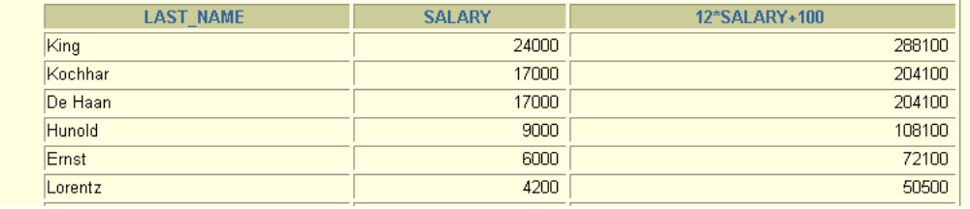
Operator Precedence
SELECT last_name, salary, 12*salary+100
FROM employees;
...
Notes:
Operator Precedence (continued)
The example in the slide displays the last name, salary, and annual compensation of each employee. It calculates the annual compensation as 12 multiplied by the monthly salary, plus a one-time bonus of $100. Notice that multiplication is performed before addition.
Note: Use parentheses to reinforce the standard order of precedence and to improve clarity. For example, the expression on the slide can be written as (12*salary)+100 with no change in the result.
Instructor Note
Demonstration: 1_prec1.sql, 1_prec2.sql
Purpose: To illustrate viewing a query containing no parentheses and executing a query with parentheses to override rules of precedence.

Slide 11
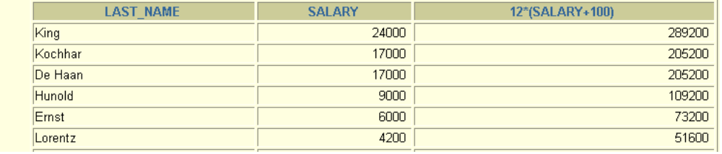
Using Parentheses
SELECT last_name, salary, 12*(salary+100)
FROM employees;
Notes:
Using Parentheses
You can override the rules of precedence by using parentheses to specify the order in which operators are executed.
The example in the slide displays the last name, salary, and annual compensation of each employee. It calculates the annual compensation as monthly salary plus a monthly bonus of $100, multiplied by 12. Because of the parentheses, addition takes priority over multiplication.

Slide 12
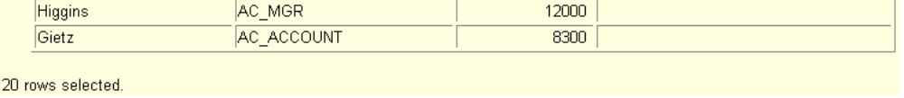
Defining a Null Value
A null is a value that is unavailable, unassigned, unknown, or inapplicable.
A null is not the same as zero or a blank space.
SELECT last_name, job_id, salary, commission_pct
FROM employees;
...
Notes:
Null Values
If a row lacks the data value for a particular column, that value is said to be null, or to contain a null.
A null is a value that is unavailable, unassigned, unknown, or inapplicable. A null is not the same as zero or a space. Zero is a number, and a space is a character.
Columns of any data type can contain nulls. However, some constraints, NOT NULL and PRIMARY KEY, prevent nulls from being used in the column.
In the COMMISSION_PCT column in the EMPLOYEES table, notice that only a sales manager or sales representative can earn a commission. Other employees are not entitled to earn commissions. A null represents that fact.
Instructor Note
Demonstration: 1_null.sql
Purpose: To illustrate calculating with null values.

Slide 13
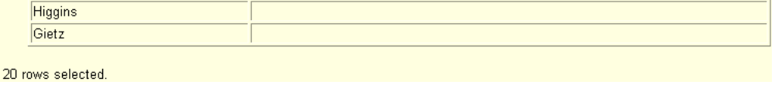
Null Values in Arithmetic Expressions
Arithmetic expressions containing a null value
evaluate to null.
SELECT last_name, 12*salary*commission_pct
FROM employees;
Notes:
Null Values (continued)
If any column value in an arithmetic expression is null, the result is null. For example, if you attempt to perform division with zero, you get an error. However, if you divide a number by null, the result is a null or unknown.
In the example on the slide, employee King does not get any commission. Because the COMMISSION_PCT column in the arithmetic expression is null, the result is null.
For more information, see Oracle9i SQL Reference, “Basic Elements of SQL.”

Slide 14
Defining a Column Alias
A column alias:
Renames a column heading
Is useful with calculations
Immediately follows the column name: there can also be the optional AS keyword between the column name and alias
Requires double quotation marks if it contains spaces or special characters or is case sensitive
Notes:
Column Aliases
When displaying the result of a query, iSQL*Plus normally uses the name of the selected column as the column heading. This heading may not be descriptive and hence may be difficult to understand. You can change a column heading by using a column alias.
Specify the alias after the column in the SELECT list using a space as a separator. By default, alias headings appear in uppercase. If the alias contains spaces or special characters (such as # or $), or is case sensitive, enclose the alias in double quotation marks (" ").
Instructor Note
Within a SQL statement, a column alias can be used in both the SELECT clause and the ORDER BY clause. You cannot use column aliases in the WHERE clause. Both alias features comply with the ANSI SQL 92 standard.
Demo: 1_alias.sql
Purpose: To illustrate the use of aliases in expressions.

Slide 15
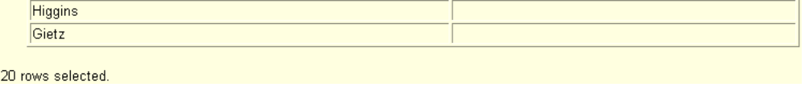
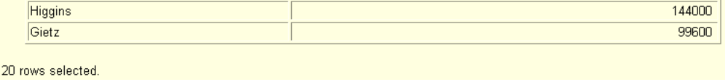
Using Column Aliases
SELECT last_name AS name, commission_pct comm
FROM employees;
SELECT last_name "Name",
salary*12 "Annual Salary"
FROM employees;
Notes:
Column Aliases (continued)
The first example displays the names and the commission percentages of all the employees. Notice that the optional AS keyword has been used before the column alias name. The result of the query is the same whether the AS keyword is used or not. Also notice that the SQL statement has the column aliases, name and comm, in lowercase, whereas the result of the query displays the column headings in uppercase. As mentioned in a previous slide, column headings appear in uppercase by default.
The second example displays the last names and annual salaries of all the employees. Because Annual Salary contains a space, it has been enclosed in double quotation marks. Notice that the column heading in the output is exactly the same as the column alias.
Instructor Note
Point out the optional AS keyword in the first example and the double quotation marks in the second example. Also show that the aliases always appear in uppercase, unless enclosed within double quotation marks.

Slide 16
Concatenation Operator
A concatenation operator:
Concatenates columns or character strings to other columns
Is represented by two vertical bars (||)
Creates a resultant column that is a character expression
Notes:
Concatenation Operator
You can link columns to other columns, arithmetic expressions, or constant values to create a character expression by using the concatenation operator (||). Columns on either side of the operator are combined to make a single output column.

Slide 17
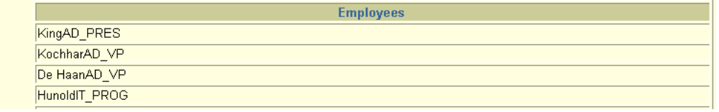
Using the Concatenation Operator
SELECT last_name||job_id AS "Employees"
FROM employees;
Notes:
Using the Concatenation Operator
In the example, LAST_NAME and JOB_ID are concatenated, and they are given the alias Employees. Notice that the employee last name and job code are combined to make a single output column.
The AS keyword before the alias name makes the SELECT clause easier to read.

Slide 18
Literal Character Strings
A literal value is a character, a number, or a date included in the SELECT list.
Date and character literal values must be enclosed within single quotation marks.
Each character string is output once for each
row returned.
Notes:
Literal Character Strings
A literal value is a character, a number, or a date that is included in the SELECT list and that is not a column name or a column alias. It is printed for each row returned. Literal strings of free-format text can be included in the query result and are treated the same as a column in the SELECT list.
Date and character literals must be enclosed within single quotation marks (' '); number literals need not.

Slide 19
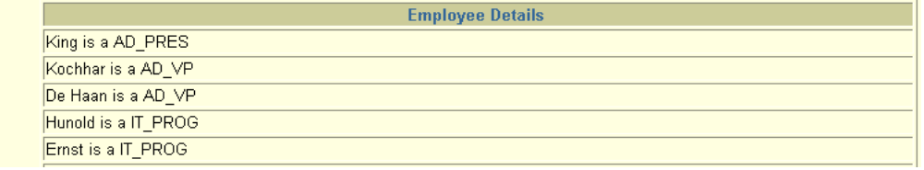
Using Literal Character Strings
SELECT last_name ||' is a '||job_id
AS "Employee Details"
FROM employees;
Notes:
Using Literal Character Strings
The example on the slide displays last names and job codes of all employees. The column has the heading Employee Details. Notice the spaces between the single quotation marks in the SELECT statement. The spaces improve the readability of the output.
In the following example, the last name and salary for each employee are concatenated with a literal to give the returned rows more meaning.
SELECT last_name ||': 1 Month salary = '||salary Monthly
FROM employees;

Slide 20
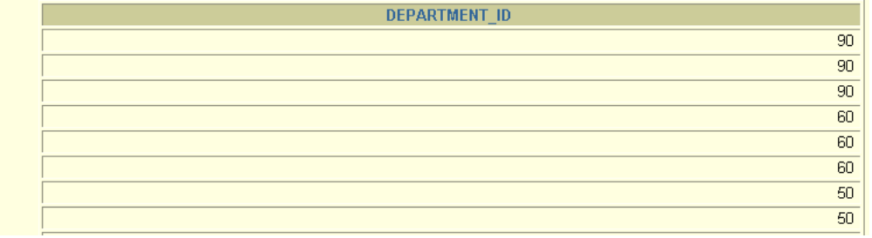
Duplicate Rows
The default display of queries is all rows, including
duplicate rows.
SELECT department_id
FROM employees;
Notes:
Duplicate Rows
Unless you indicate otherwise, iSQL*Plus displays the results of a query without eliminating duplicate rows. The example on the slide displays all the department numbers from the EMPLOYEES table. Notice that the department numbers are repeated.

Slide 21
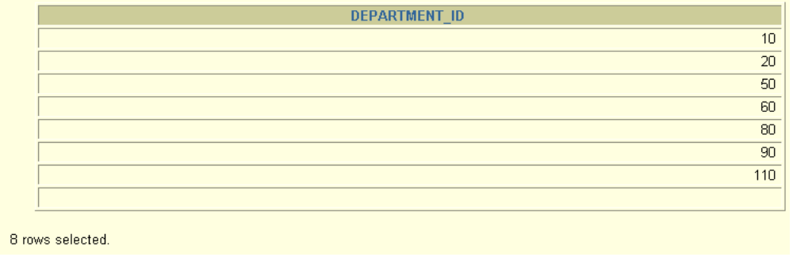
Eliminating Duplicate Rows
Eliminate duplicate rows by using the DISTINCT keyword in the SELECT clause.
SELECT DISTINCT department_id
FROM employees;
Notes:
Eliminating Duplicate Rows
To eliminate duplicate rows in the result, include the DISTINCT keyword in the SELECT clause immediately after the SELECT keyword. In the example on the slide, the EMPLOYEES table actually contains 20 rows but there are only seven unique department numbers in the table.
You can specify multiple columns after the DISTINCT qualifier. The DISTINCT qualifier affects all the selected columns, and the result is every distinct combination of the columns.
SELECT DISTINCT department_id, job_id
FROM employees;

Slide 22
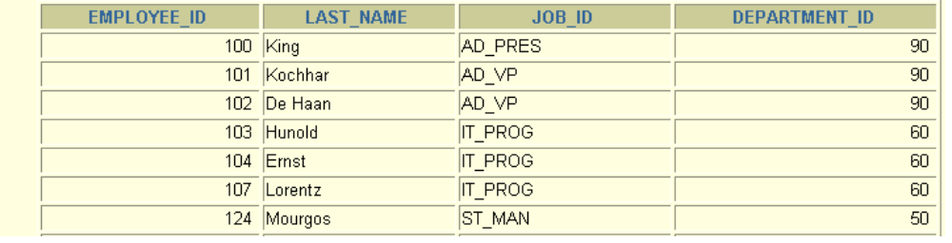
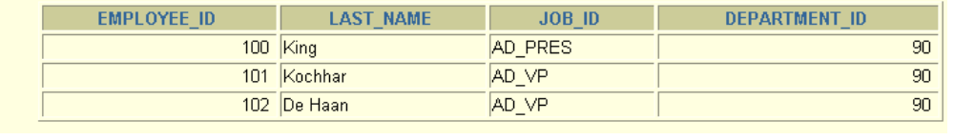
Limiting Rows Using a Selection
EMPLOYEES
“retrieve all
employees
in department 90”
Notes:
Limiting Rows Using a Selection
In the example in the slide, assume that you want to display all the employees in department 90. The rows with a value of 90 in the DEPARTMENT_ID column are the only ones returned. This method of restriction is the basis of the WHERE clause in SQL.

Slide 23
Limiting the Rows Selected
Restrict the rows returned by using the WHERE clause.
The WHERE clause follows the FROM clause.
SELECT *|{[DISTINCT] column|expression [alias],...}
FROM table
[WHERE condition(s)];
Notes:
Limiting the Rows Selected
You can restrict the rows returned from the query by using the WHERE clause. A WHERE clause contains a condition that must be met, and it directly follows the FROM clause. If the condition is true, the row meeting the condition is returned.
In the syntax:
WHERE restricts the query to rows that meet a condition
condition is composed of column names, expressions, constants, and a comparison operator
The WHERE clause can compare values in columns, literal values, arithmetic expressions, or functions. It consists of three elements:
Column name
Comparison condition
Column name, constant, or list of values

Slide 24
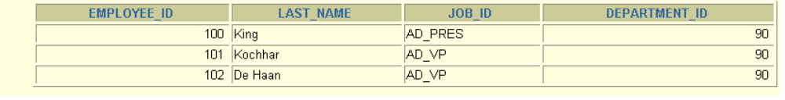
Using the WHERE Clause
SELECT employee_id, last_name, job_id, department_id
FROM employees
WHERE department_id = 90;
Notes:
Using the WHERE Clause
In the example, the SELECT statement retrieves the name, job ID, and department number of all employees whose job ID is SA_REP.
Note that the job title SA_REP has been specified in uppercase to ensure that it matches the job ID column in the EMPLOYEES table. Character strings are case sensitive.

Slide 25
Character Strings and Dates
Character strings and date values are enclosed in single quotation marks.
Character values are case sensitive, and date values are format sensitive.
The default date format is DD-MON-RR.
SELECT last_name, job_id, department_id
FROM employees
WHERE last_name = 'Goyal';
Notes:
Character Strings and Dates
Character strings and dates in the WHERE clause must be enclosed in single quotation marks (''). Number constants, however, should not be enclosed in single quotation marks.
All character searches are case sensitive. In the following example, no rows are returned because the EMPLOYEES table stores all the last names in the proper case:
SELECT last_name, job_id, department_id
FROM employees
WHERE last_name = 'GOYAL';
Oracle databases store dates in an internal numeric format, representing the century, year, month, day, hours, minutes, and seconds. The default date display is DD-MON-RR.
Note: Changing the default date format is covered in a subsequent lesson.
Instructor Note
Some students may ask how to override the case sensitivity. Later in the course, we cover the use of single-row functions such as UPPER and LOWER to override the case sensitivity.

Slide 26
Comparison Conditions
Operator
=
>
>=
<
<=
<>
Meaning
Equal to
Greater than
Greater than or equal to
Less than
Less than or equal to
Not equal to
Notes:
Comparison Conditions
Comparison conditions are used in conditions that compare one expression to another value or expression. They are used in the WHERE clause in the following format:
... WHERE expr operator value
Example
... WHERE hire_date='01-JAN-95'
... WHERE salary>=6000
... WHERE last_name='Smith'
An alias cannot be used in the WHERE clause.
Note: The symbol != and ^= can also represent the not equal to condition.

Slide 27
Other Comparison Conditions
Operator
BETWEEN
...AND...
IN(set)
LIKE
IS NULL
Meaning
Between two values (inclusive)
Match any of a list of values
Match a character pattern
Is a null value

Slide 28
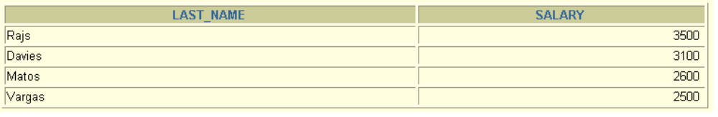
Using the BETWEEN Condition
Use the BETWEEN condition to display rows based on a range of values.
SELECT last_name, salary
FROM employees
WHERE salary BETWEEN 2500 AND 3500;
Lower limit
Upper limit
Notes:
The BETWEEN Condition
You can display rows based on a range of values using the BETWEEN range condition. The range that you specify contains a lower limit and an upper limit.
The SELECT statement on the slide returns rows from the EMPLOYEES table for any employee whose salary is between $2,500 and $3,500.
Values specified with the BETWEEN condition are inclusive. You must specify the lower limit first.
Instructor Note
Emphasize that the values specified with the BETWEEN operator in the example are inclusive. Explain that BETWEEN … AND … is actually translated by the Oracle server to a pair of AND conditions: (a >= lower limit) AND (a <= higher limit). So using BETWEEN … AND … has no performance benefits, and it is used for logical simplicity.
Demonstration: 2_betw.sql
Purpose: To illustrate using the BETWEEN operator.

Slide 29
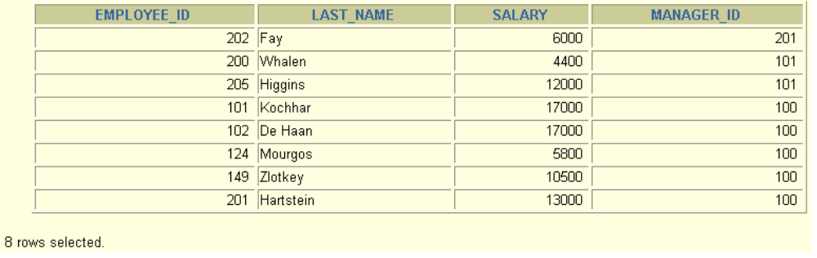
Using the IN Condition
Use the IN membership condition to test for values in
a list.
SELECT employee_id, last_name, salary, manager_id
FROM employees
WHERE manager_id IN (100, 101, 201);
Notes:
The IN Condition
To test for values in a specified set of values, use the IN condition. The IN condition is also known as the membership condition.
The example displays employee numbers, last names, salaries, and manager’s employee numbers for all the employees whose manager’s employee number is 100, 101, or 201.
The IN condition can be used with any data type. The following example returns a row from the EMPLOYEES table for any employee whose last name is included in the list of names in the WHERE clause:
SELECT employee_id, manager_id, department_id
FROM employees
WHERE last_name IN ('Hartstein', 'Vargas');
If characters or dates are used in the list, they must be enclosed in single quotation marks ('').
Instructor Note
Explain that IN ( ... ) is actually translated by the Oracle server to a set of OR conditions: a = value1 OR a = value2 OR a = value3. So using IN ( ... ) has no performance benefits, and it is used for logical simplicity.
Demonstration: 2_in.sql
Purpose: To illustrate using the IN operator.

Slide 30
Using the LIKE Condition
Use the LIKE condition to perform wildcard searches of valid search string values.
Search conditions can contain either literal characters or numbers:
  % denotes zero or many characters.
  _ denotes one character.
SELECT first_name
FROM employees
WHERE first_name LIKE 'S%';
Notes:
The LIKE Condition
You may not always know the exact value to search for. You can select rows that match a character pattern by using the LIKE condition. The character pattern-matching operation is referred to as a wildcard search. Two symbols can be used to construct the search string.
The SELECT statement on the slide returns the employee first name from the EMPLOYEES table for any employee whose first name begins with an S. Note the uppercase S. Names beginning with an s are not returned.
The LIKE condition can be used as a shortcut for some BETWEEN comparisons. The following example displays the last names and hire dates of all employees who joined between January 1995 and December 1995:
SELECT last_name, hire_date
FROM employees
WHERE hire_date LIKE '%95';

Slide 31
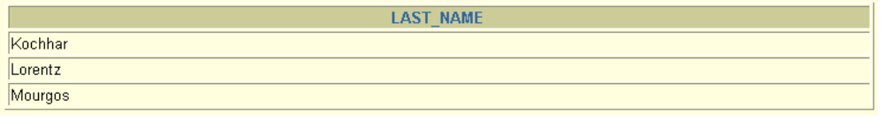
Using the LIKE Condition
You can combine pattern-matching characters.
You can use the ESCAPE identifier to search for the actual % and _ symbols.
SELECT last_name
FROM employees
WHERE last_name LIKE '_o%';
Notes:
Combining Wildcard Characters
The % and _ symbols can be used in any combination with literal characters. The example on the slide displays the names of all employees whose last name has an o as the second character.
The ESCAPE Option
When you need to have an exact match for the actual % and _ characters, use the ESCAPE option. This option specifies what the escape character is. If you want to search for strings that contain SA_, you can search for it using the following SQL statement:
SELECT employee_id, last_name, job_id
FROM employees
WHERE job_id LIKE '%SA\_%' ESCAPE '\';
The ESCAPE option identifies the backslash (\) as the escape character. In the pattern, the escape character precedes the underscore (_). This causes the Oracle Server to interpret the underscore literally.

Slide 32
Using the NULL Conditions
Test for nulls with the IS NULL operator.
SELECT last_name, manager_id
FROM employees
WHERE manager_id IS NULL;
Notes:
The NULL Conditions
The NULL conditions include the IS NULL condition and the IS NOT NULL condition.
The IS NULL condition tests for nulls. A null value means the value is unavailable, unassigned, unknown, or inapplicable. Therefore, you cannot test with = because a null cannot be equal or unequal to any value. The slide example retrieves the last names and managers of all employees who do not have a manager.
For another example, to display last name, job ID, and commission for all employees who are not entitled to get a commission, use the following SQL statement:
SELECT last_name, job_id, commission_pct
FROM employees
WHERE commission_pct IS NULL;

Slide 33
Logical Conditions
Operator
AND
OR
NOT
Meaning
Returns TRUE if both component conditions are true
Returns TRUE if either component condition is true
Returns TRUE if the following condition is false
Notes:
Logical Conditions
A logical condition combines the result of two component conditions to produce a single result based on them or inverts the result of a single condition. A row is returned only if the overall result of the condition is true. Three logical operators are available in SQL:
AND
OR
NOT
All the examples so far have specified only one condition in the WHERE clause. You can use several conditions in one WHERE clause using the AND and OR operators.

Slide 34
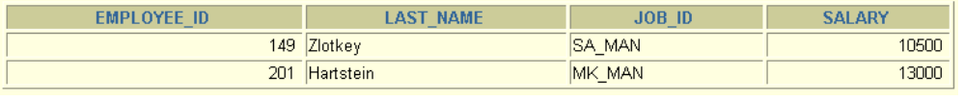
Using the AND Operator
AND requires both conditions to be true.
SELECT employee_id, last_name, job_id, salary
FROM employees
WHERE salary >=10000
AND job_id LIKE '%MAN%';
Notes:
The AND Operator
In the example, both conditions must be true for any record to be selected. Therefore, only employees who have a job title that contains the string MAN and earn more than $10,000 are selected.
All character searches are case sensitive. No rows are returned if MAN is not in uppercase. Character strings must be enclosed in quotation marks.
AND Truth Table
The following table shows the results of combining two expressions with AND:
Instructor Note
Demonstration: 2_and.sql
Purpose: To illustrate using the AND operator.

Slide 35
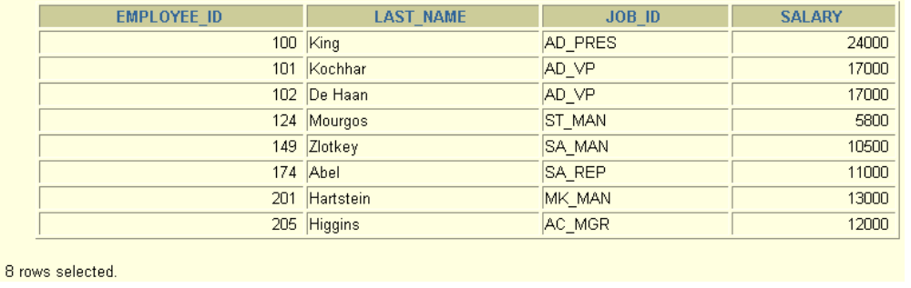
Using the OR Operator
  OR requires either condition to be true.
SELECT employee_id, last_name, job_id, salary
FROM employees
WHERE salary >= 10000
OR job_id LIKE '%MAN%';
Notes:
The OR Operator
In the example, either condition can be true for any record to be selected. Therefore, any employee who has a job ID containing MAN or earns more than $10,000 is selected.
The OR Truth Table
The following table shows the results of combining two expressions with OR:
Instructor Note
Demonstration: 2_or.sql
Purpose: To illustrate using the OR operator.

Slide 36
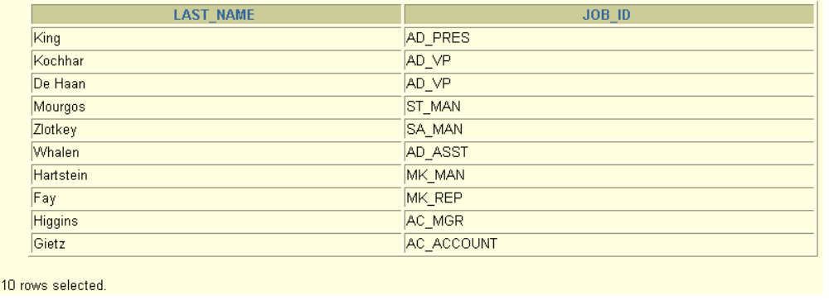
Using the NOT Operator
SELECT last_name, job_id
FROM employees
WHERE job_id NOT IN ('IT_PROG', 'ST_CLERK', 'SA_REP');
Notes:
The NOT Operator
The slide example displays the last name and job ID of all employees whose job ID is not IT_PROG, ST_CLERK, or SA_REP.
The NOT Truth Table
The following table shows the result of applying the NOT operator to a condition:
Note: The NOT operator can also be used with other SQL operators, such as BETWEEN, LIKE, and NULL.
... WHERE job_id NOT IN ('AC_ACCOUNT', 'AD_VP')
... WHERE salary NOT BETWEEN 10000 AND 15000
... WHERE last_name NOT LIKE '%A%'
... WHERE commission_pct IS NOT NULL

Slide 37
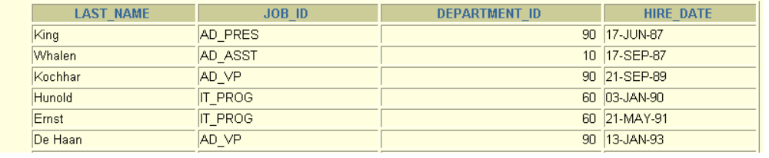
ORDER BY Clause
Sort rows with the ORDER BY clause
  ASC: ascending order (the default order)
  DESC: descending order
The ORDER BY clause comes last in the SELECT statement.
SELECT last_name, job_id, department_id, hire_date
FROM employees
ORDER BY hire_date;
Notes:
The ORDER BY Clause
The order of rows returned in a query result is undefined. The ORDER BY clause can be used to sort the rows. If you use the ORDER BY clause, it must be the last clause of the SQL statement. You can specify an expression, or an alias, or column position as the sort condition.
Syntax
SELECT expr
FROM table
[WHERE condition(s)]
[ORDER BY {column, expr} [ASC|DESC]];
In the syntax:
ORDER BY specifies the order in which the retrieved rows are displayed
ASC orders the rows in ascending order (this is the default order)
DESC orders the rows in descending order
If the ORDER BY clause is not used, the sort order is undefined, and the Oracle server may not fetch rows in the same order for the same query twice. Use the ORDER BY clause to display the rows in a specific order.
Instructor Note
Let the students know that the ORDER BY clause is executed last in query execution. It is placed last unless the FOR UPDATE clause is used.

Slide 38
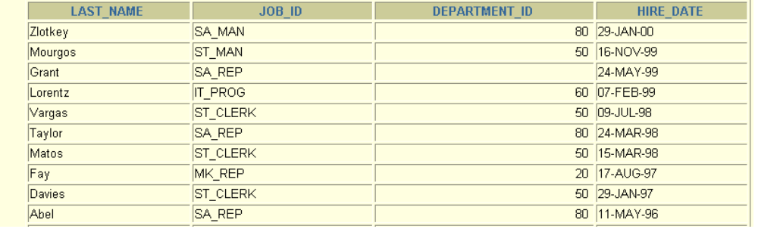
Sorting in Descending Order
SELECT last_name, job_id, department_id, hire_date
FROM employees
ORDER BY hire_date DESC;
Notes:
Default Ordering of Data
The default sort order is ascending:
Numeric values are displayed with the lowest values first: for example, 1–999.
Date values are displayed with the earliest value first: for example, 01-JAN-92 before
01-JAN-95.
Character values are displayed in alphabetical order: for example, A first and Z last.
Null values are displayed last for ascending sequences and first for descending sequences.
Reversing the Default Order
To reverse the order in which rows are displayed, specify the DESC keyword after the column name in the ORDER BY clause. The slide example sorts the result by the most recently hired employee.
Instructor Note
Let the students know that you can also sort by a column number in the SELECT list. The following example sorts the output in the descending order by salary:
SELECT last_name, salary
FROM employees
ORDER BY 2 DESC;

Slide 39
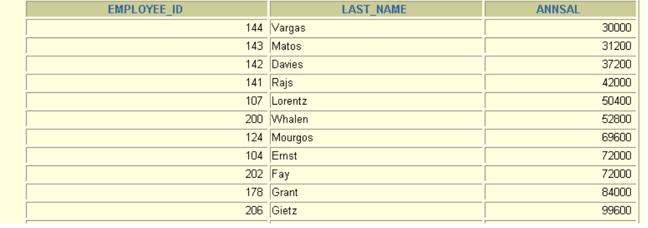
Sorting by Column Alias
SELECT employee_id, last_name, salary*12 annsal
FROM employees
ORDER BY annsal;
Notes:
Sorting by Column Aliases
You can use a column alias in the ORDER BY clause. The slide example sorts the data by annual salary.
Instructor Note
Internally, the order of execution for a SELECT statement is as follows:
FROM clause
WHERE clause
SELECT clause
ORDER BY clause

Slide 40
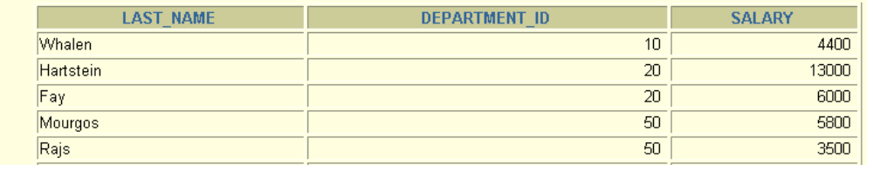
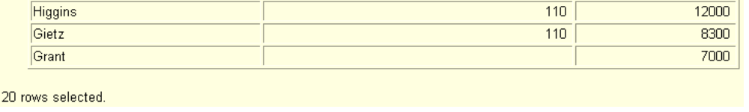
Sorting by Multiple Columns
The order of ORDER BY list is the order of sort.
You can sort by a column that is not in the
SELECT list.
SELECT last_name, department_id, salary
FROM employees
ORDER BY department_id, salary DESC;
Notes:
Sorting by Multiple Columns
You can sort query results by more than one column. The sort limit is the number of columns in the given table.
In the ORDER BY clause, specify the columns, and separate the column names using commas. If you want to reverse the order of a column, specify DESC after its name. You can also order by columns that are not included in the SELECT clause.
Example
Display the last names and salaries of all employees. Order the result by department number, and then in descending order by salary.
SELECT last_name, salary
FROM employees
ORDER BY department_id, salary DESC;
Instructor Note
Show that the DEPARTMENT_ID column is sorted in ascending order and the SALARY column in descending order.

Slide 41
SQL Functions
Input
Function
Output
arg 1
Function performs action
arg 2
Result
value
arg n
Notes:
SQL Functions
Functions are a very powerful feature of SQL and can be used to do the following:
Perform calculations on data
Modify individual data items
Manipulate output for groups of rows
Format dates and numbers for display
Convert column data types
SQL functions sometimes take arguments and always return a value.
Note: Most of the functions described in this lesson are specific to Oracle Corporation’s version of SQL.
Instructor Note
This lesson does not discuss all functions in great detail. It presents the most common functions with a brief explanation of them.

Slide 42
Two Types of SQL Functions
Functions
Single-row
functions
Multiple-row
functions
Notes:
Types of SQL Functions
There are two distinct types of functions:
Single-row functions
Multiple-row functions
Single-Row Functions
These functions operate on single rows only and return one result per row. There are different types of single-row functions. This lesson covers the following ones:
Character
Number
Date
Conversion
Multiple-Row Functions
Functions can manipulate groups of rows to give one result per group of rows. These functions are known as group functions. This is covered in a later lesson.
For more information, see Oracle9i SQL Reference for the complete list of available functions and their syntax.

Slide 43
Single-Row Functions
Single row functions:
Manipulate data items
Accept arguments and return one value
Act on each row returned
Return one result per row
May modify the data type
Can be nested
Accept arguments which can be a column or an expression
function_name [(arg1, arg2,...)]
Notes:
Single-Row Functions
Single-row functions are used to manipulate data items. They accept one or more arguments and return one value for each row returned by the query. An argument can be one of the following:
User-supplied constant
Variable value
Column name
Expression
Features of single-row functions include:
Acting on each row returned in the query
Returning one result per row
Possibly returning a data value of a different type than that referenced
Possibly expecting one or more arguments
Can be used in SELECT, WHERE, and ORDER BY clauses; can be nested
In the syntax:
function_name is the name of the function.
arg1, arg2 is any argument to be used by the function.
This can be represented by a column name or expression.

Slide 44
Character Functions
Character
functions
Case-manipulation
functions
Character-manipulation
functions
LOWER
UPPER
INITCAP
CONCAT
SUBSTR
LENGTH
INSTR
LPAD | RPAD
TRIM
REPLACE
Notes:
Character Functions
Single-row character functions accept character data as input and can return both character and numeric values. Character functions can be divided into the following:
Case-manipulation functions
Character-manipulation functions
Note: The functions discussed in this lesson are only some of the available functions.

Slide 45
Case Manipulation Functions
These functions convert case for character strings.
Function
Result
LOWER('SQL Course')
UPPER('SQL Course')
INITCAP('SQL Course')
sql course
SQL COURSE
Sql Course
Notes:
Case Manipulation Functions
LOWER, UPPER, and INITCAP are the three case-conversion functions.
LOWER: Converts mixed case or uppercase character strings to lowercase
UPPER: Converts mixed case or lowercase character strings to uppercase
INITCAP: Converts the first letter of each word to uppercase and remaining letters to lowercase
SELECT 'The job id for '||UPPER(last_name)||' is '
||LOWER(job_id) AS "EMPLOYEE DETAILS"
FROM employees;

Slide 46
Character-Manipulation Functions
These functions manipulate character strings:
Function
Result
CONCAT('Hello', 'World')
SUBSTR('HelloWorld',1,5)
LENGTH('HelloWorld')
INSTR('HelloWorld', 'W')
LPAD(salary,10,'*')
RPAD(salary, 10, '*')
TRIM('H' FROM 'HelloWorld')
HelloWorld
Hello
10
6
*****24000
24000*****
elloWorld
Notes:
Character Manipulation Functions
CONCAT, SUBSTR, LENGTH, INSTR, LPAD, RPAD, and TRIM are the character manipulation functions covered in this lesson.
CONCAT: Joins values together (you are limited to using two parameters with CONCAT
SUBSTR: Extracts a string of determined length
LENGTH: Shows the length of a string as a numeric value
INSTR: Finds numeric position of a named character
LPAD: Pads the character value right-justified
RPAD: Pads the character value left-justified
TRIM: Trims heading or trailing characters (or both) from a character string (If trim_character or trim_source is a character literal, you must enclose it in single quotes.)
Instructor Note
Be sure to point out RPAD to the students, because this function is needed in a practice exercise. Also, TRIM, which was a new function in Oracle8i, does the job of both the LTRIM and the RTRIM functions.

Slide 47
Number Functions
ROUND: Rounds value to specified decimal
    ROUND(45.926, 2) 45.93
TRUNC: Truncates value to specified decimal
    TRUNC(45.926, 2) 45.92
MOD: Returns remainder of division
    MOD(1600, 300) 100
Notes:
Number Functions
Number functions accept numeric input and return numeric values. This section describes some of the number functions.
Note: This list contains only some of the available number functions.
For more information, see Oracle9i SQL Reference, “Number Functions.”

Slide 48
Working with Dates
SYSDATE is a function that returns:
Date
Time
Notes:
The SYSDATE Function
SYSDATE is a date function that returns the current database server date and time. You can use SYSDATE just as you would use any other column name. For example, you can display the current date by selecting SYSDATE from a table. It is customary to select SYSDATE from a dummy table called DUAL.
Example
Display the current date using the DUAL table.
SELECT SYSDATE
FROM DUAL;

Slide 49
Arithmetic with Dates
Add or subtract a number to or from a date for a resultant date value.
Subtract two dates to find the number of days between those dates.
Add hours to a date by dividing the number of hours by 24.
Notes:
Arithmetic with Dates
Because the database stores dates as numbers, you can perform calculations using arithmetic operators such as addition and subtraction. You can add and subtract number constants as well as dates.
You can perform the following operations:

Slide 50
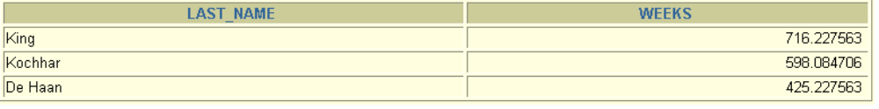
Using Arithmetic Operators with Dates
SELECT last_name, (SYSDATE-hire_date)/7 AS WEEKS
FROM employees
WHERE department_id = 90;
Notes:
Using Arithmetic Operators with Dates
The example in the slide displays the last name and the number of weeks employed for all employees in department 90. It subtracts the date on which the employee was hired from the current date (SYSDATE) and divides the result by 7 to calculate the number of weeks that a worker has been employed.
Note: SYSDATE is a SQL function that returns the current date and time. Your results may differ from the example.
If a more current date is subtracted from an older date, the difference is a negative number.

Slide 51
Date Functions
Function
Description
MONTHS_BETWEEN
Number of months
between two dates
ADD_MONTHS
Add calendar months to date
NEXT_DAY
Next day of the date specified
LAST_DAY
Last day of the month
ROUND
Round date
TRUNC
Truncate date
Notes:
Date Functions
Date functions operate on Oracle dates. All date functions return a value of DATE data type except MONTHS_BETWEEN, which returns a numeric value.
MONTHS_BETWEEN(date1, date2): Finds the number of months between date1 and date2. The result can be positive or negative. If date1 is later than date2, the result is positive; if date1 is earlier than date2, the result is negative. The noninteger part of the result represents a portion of the month.
ADD_MONTHS(date, n): Adds n number of calendar months to date. The value of n must be an integer and can be negative.
NEXT_DAY(date, 'char'): Finds the date of the next specified day of the week ('char') following date. The value of char may be a number representing a day or a character string.
LAST_DAY(date): Finds the date of the last day of the month that contains date.
ROUND(date[,'fmt']): Returns date rounded to the unit specified by the format model fmt. If the format model fmt is omitted, date is rounded to the nearest day.
TRUNC(date[, 'fmt']): Returns date with the time portion of the day truncated to the unit specified by the format model fmt. If the format model fmt is omitted, date is truncated to the nearest day.
This list is a subset of the available date functions. The format models are covered later in this lesson. Examples of format models are month and year.

Slide 52
Using Date Functions
MONTHS_BETWEEN ('01-SEP-95','11-JAN-94')
19.6774194
ADD_MONTHS ('11-JAN-94',6)
'11-JUL-94'
NEXT_DAY ('01-SEP-95','FRIDAY')
'08-SEP-95'
LAST_DAY('01-FEB-95')
'28-FEB-95'
Notes:
Using Date Functions
For example, display the employee number, hire date, number of months employed, six-month review date, first Friday after hire date, and last day of the month when hired for all employees employed for fewer than 36 months.
SELECT employee_id, hire_date,
MONTHS_BETWEEN (SYSDATE, hire_date) TENURE,
ADD_MONTHS (hire_date, 6) REVIEW,
NEXT_DAY (hire_date, 'FRIDAY'), LAST_DAY(hire_date)
FROM employees
WHERE MONTHS_BETWEEN (SYSDATE, hire_date) < 36;

Slide 53
Conversion Functions
Data-type
conversion
Implicit data-type
conversion
Explicit data-type
conversion
Notes:
Conversion Functions
In addition to Oracle data types, columns of tables in an Oracle9i database can be defined using ANSI, DB2, and SQL/DS data types. However, the Oracle Server internally converts such data types to Oracle8 data types.
In some cases, the Oracle Server uses data of one data type where it expects data of a different data type. This can happen when the Oracle Server can automatically convert the data to the expected data type. This data type conversion can be done implicitly by the Oracle Server, or explicitly by the user.
Implicit data-type conversions work according to the rules explained in the next two slides.
Explicit data-type conversions are done by using the conversion functions. Conversion functions convert a value from one data type to another. Generally, the form of the function names follows the convention data type TO data type. The first data type is the input data type; the last data type is the output.
Note: Although implicit data-type conversion is available, it is recommended that you do explicit data type conversion to ensure the reliability of your SQL statements.

Slide 54
Explicit Data Type Conversion
TO_NUMBER
TO_DATE
NUMBER
CHARACTER
DATE
TO_CHAR
TO_CHAR
Notes:
Explicit Data-Type Conversion (continued)
Note: The list of functions mentioned in this lesson includes only some of the available conversion functions.
For more information, see Oracle9i SQL Reference, “Conversion Functions.”

Slide 55
Using the TO_CHAR Function with Dates
TO_CHAR(date, 'format_model')
The format model:
Must be enclosed in single quotation marks and is case sensitive
Can include any valid date format element
Is separated from the date value by a comma
Notes:
Displaying a Date in a Specific Format
Previously, all Oracle date values were displayed in the DD-MON-YY format. You can use the TO_CHAR function to convert a date from this default format to one specified by you.
Guidelines
The format model must be enclosed in single quotation marks and is case sensitive.
The format model can include any valid date format element. Be sure to separate the date value from the format model by a comma.
The names of days and months in the output are automatically padded with blanks.
To remove padded blanks or to suppress leading zeros, use the fill mode fm element.
You can format the resulting character field with the iSQL*Plus COLUMN command covered in a later lesson.
SELECT employee_id, TO_CHAR(hire_date, 'MM/YY') Month_Hired
FROM employees
WHERE last_name = 'Higgins';

Slide 56
Elements of the Date Format Model
YYYY
Full year in numbers
YEAR
Year spelled out
MM
Two-digit value for month
MONTH
Full name of the month
Three-letter abbreviation of the month
MON
Three-letter abbreviation of the day of the week
DY
DAY
Full name of the day of the week
DD
Numeric day of the month

Slide 57
Using the TO_CHAR Function with Numbers
TO_CHAR(number, 'format_model')
These are some of the format elements you can use with the TO_CHAR function to display a number value as a character:
9
Represents a number
0
Forces a zero to be displayed
$
Places a floating dollar sign
L
Uses the floating local currency symbol
.
Prints a decimal point
,
Prints a thousand indicator
Notes:
The TO_CHAR Function with Numbers
When working with number values such as character strings, you should convert those numbers to the character data type using the TO_CHAR function, which translates a value of NUMBER data type to VARCHAR2 data type. This technique is especially useful with concatenation.
Number Format Elements
If you are converting a number to the character data type, you can use the following format elements:

Slide 58
Using the TO_CHAR Function with Numbers
SELECT TO_CHAR(salary, '$99,999.00') SALARY
FROM employees
WHERE last_name = 'Ernst';
Notes:
Guidelines
The Oracle Server displays a string of hash signs (#) in place of a whole number whose digits exceed the number of digits provided in the format model.
The Oracle Server rounds the stored decimal value to the number of decimal spaces provided in the format model.
Instructor Note (for page 3-39)
You can demonstrate the code using the fx modifier in the file 3_39n. Run the file with the fx modifier present, then remove the fx modifer and run the statement again.

Slide 59
Using the TO_NUMBER and TO_DATE Functions
Convert a character string to a number format using the TO_NUMBER function:
Convert a character string to a date format using the TO_DATE function:
TO_NUMBER(char[, 'format_model'])
TO_DATE(char[, 'format_model'])
Notes:
The TO_NUMBER and TO_DATE Functions
You may want to convert a character string to either a number or a date. To accomplish this task, you use the TO_NUMBER or TO_DATE functions. The format model you choose is based on the previously demonstrated format elements.
The fx modifier specifies exact matching for the character argument and date format model of a TO_DATE function:
Punctuation and quoted text in the character argument must exactly match (except for case) the corresponding parts of the format model.
The character argument cannot have extra blanks. Without fx, the Oracle Server ignores extra blanks.
Numeric data in the character argument must have the same number of digits as the corresponding element in the format model. Without fx, numbers in the character argument can omit leading zeroes.
Example
Display the names and hire dates of all the employees who joined on May 24, 1999. Because the fx modifier is used, an exact match is required and the spaces after the word “May” are not recognized.
SELECT last_name, hire_date
FROM employees
WHERE hire_date = TO_DATE('May 24, 1999', 'fxMonth DD, YYYY')

Slide 60
Nesting Functions
Single-row functions can be nested to any level.
Nested functions are evaluated from deepest level to the least deep level.
F3(F2(F1(col,arg1),arg2),arg3)
Step 1 = Result 1
Step 2 = Result 2
Step 3 = Result 3
Notes:
Nesting Functions
Single-row functions can be nested to any depth. Nested functions are evaluated from the innermost level to the outermost level. Some examples follow to show you the flexibility of these functions.

Slide 61
Nesting Functions
SELECT last_name,
NVL(TO_CHAR(manager_id), 'No Manager')
FROM employees
WHERE manager_id IS NULL;
Notes:
Nesting Functions (continued)
The slide example displays the head of the company, who has no manager. The evaluation of the SQL statement involves two steps:
1. Evaluate the inner function to convert a number value to a character string.
Result1 = TO_CHAR(manager_id)
2. Evaluate the outer function to replace the null value with a text string.
NVL(Result1, 'No Manager')
The entire expression becomes the column heading because no column alias was given.
Example
Display the date of the next Friday that is six months from the hire date. The resulting date should appear as Friday, August 13th, 1999. Order the results by hire date.
SELECT TO_CHAR(NEXT_DAY(ADD_MONTHS
(hire_date, 6), 'FRIDAY'),
'fmDay, Month DDth, YYYY')
"Next 6 Month Review"
FROM employees
ORDER BY hire_date;
Instructor Note
Demonstration: 3_nest.sql
Purpose: To illustrate nesting of several single row functions.

Slide 62
General Functions
These functions work with any data type and pertain
to using null value.
NVL (expr1, expr2)
NVL2 (expr1, expr2, expr3)
COALESCE (expr1, expr2, ..., exprn)
Notes:
General Functions
These functions work with any data type and pertain to the use of null values in the expression list.
Note: For more information on the hundreds of functions available, see Oracle9i SQL Reference, “Functions.”

Slide 63
NVL Function
Converts a null to an actual value
Data types that can be used are date, character, and number.
Data types must match:
  NVL(commission_pct,0)
  NVL(hire_date,'01-JAN-97')
  NVL(job_id,'No Job Yet')
Notes:
The NVL Function
To convert a null value to an actual value, use the NVL function.
Syntax
NVL (expr1, expr2)
In the syntax:
expr1 is the source value or expression that may contain a null
expr2 is the target value for converting the null
You can use the NVL function to convert any data type, but the return value is always the same as the data type of expr1.
NVL Conversions for Various Data Types

Slide 64
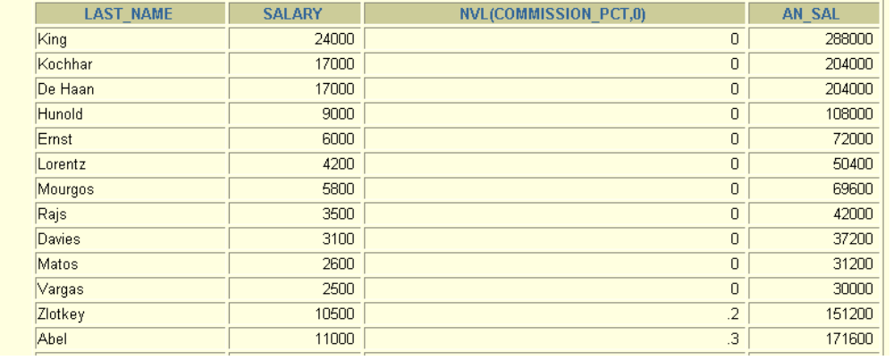
Using the NVL Function
SELECT last_name, salary, NVL(commission_pct, 0),
(salary*12) + (salary*12*NVL(commission_pct, 0)) AN_SAL
FROM employees;
Notes:
The NVL Function
To calculate the annual compensation of all employees, you need to multiply the monthly salary by 12 and then add the commission percentage to it.
SELECT last_name, salary, commission_pct,
(salary*12) + (salary*12*commission_pct) AN_SAL
FROM employees;
Notice that the annual compensation is calculated only for those employees who earn a commission. If any column value in an expression is null, the result is null. To calculate values for all employees, you must convert the null value to a number before applying the arithmetic operator. In the example in the slide, the NVL function is used to convert null values to zero.

Slide 65
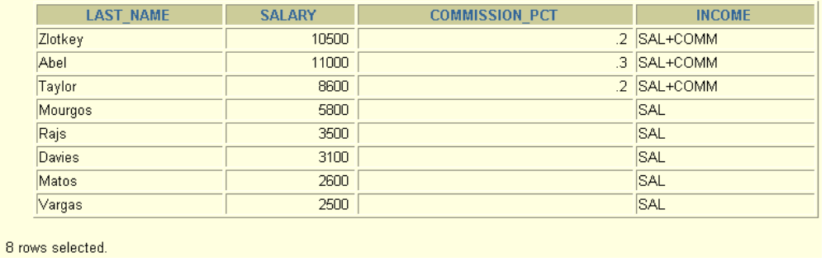
Using the NVL2 Function
SELECT last_name, salary, commission_pct,
NVL2(commission_pct,
'SAL+COMM', 'SAL') income
FROM employees WHERE department_id IN (50, 80);
Notes:
The NVL2 Function
The NVL2 function examines the first expression. If the first expression is not null, then the NVL2 function returns the second expression. If the first expression is null, then the third expression is returned.
Syntax
NVL(expr1, expr2, expr3)
In the syntax:
expr1 is the source value or expression that may contain null
expr2 is the value returned if expr1 is not null
expr3 is the value returned if expr2 is null
In the example shown, the COMMISSION_PCT column is examined. If a value is detected, the second expression of SAL+COMM is returned. If the COMMISSION_PCT column holds a null values, the third expression of SAL is returned.
The argument expr1 can have any data type. The arguments expr2 and expr3 can have any data types except LONG. If the data types of expr2 and expr3 are different, The Oracle Server converts expr3 to the data type of expr2 before comparing them unless expr3 is a null constant. In that case, a data type conversion is not necessary.
The data type of the return value is always the same as the data type of expr2, unless expr2 is character data, in which case the return value’s data type is VARCHAR2.

Slide 66
Using the COALESCE Function
The advantage of the COALESCE function over the NVL function is that the COALESCE function can take multiple alternate values.
If the first expression is not null, it returns that expression; otherwise, it does a COALESCE of the remaining expressions.
Notes:
Using The COALESCE Function
The COALESCE function returns the first nonnull expression in the list.
Syntax
COALESCE (expr1, expr2, ... exprn)
In the syntax:
expr1 returns this expression if it is not null
expr2 returns this expression if the first expression is null and this expression is not null
exprn returns this expression if the preceding expressions are null

Slide 67
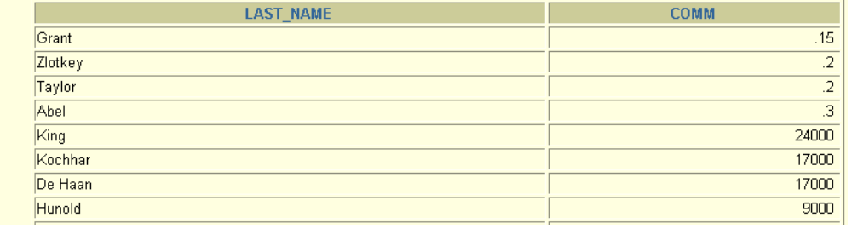
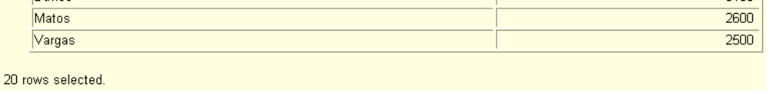
Using the COALESCE Function
SELECT last_name,
COALESCE(commission_pct, salary, 10) comm
FROM employees
ORDER BY commission_pct;
Notes:
Using the COALESCE Function (continued)
In the example in the slide, if the COMMISSION_PCT value is not null, it is shown. If the COMMISSION_PCT value is null, then the SALARY is shown. If the COMMISSION_PCT and SALARY values are null, then the value 10 is shown.

Slide 68
Conditional Expressions
Give you the use of IF-THEN-ELSE logic within a SQL statement
Use two methods:
  CASE expression
  DECODE function
Notes:
Conditional Expressions
Two methods used to implement conditional processing (IF-THEN-ELSE logic) within a SQL statement are the CASE expression and the DECODE function.
Note: The CASE expression is new in the Oracle9i Server release. The CASE expression complies with ANSI SQL, DECODE is specific to Oracle syntax.

Slide 69
The CASE Expression
Facilitates conditional inquiries by doing the work of
an IF-THEN-ELSE statement:
CASE expr WHEN comparison_expr1 THEN return_expr1
[WHEN comparison_expr2 THEN return_expr2
WHEN comparison_exprn THEN return_exprn
ELSE else_expr]
END
Notes:
The CASE Expression
CASE expressions let you use IF-THEN-ELSE logic in SQL statements without having to invoke procedures.
In a simple CASE expression, the Oracle Server searches for the first WHEN ... THEN pair for which expr is equal to comparison_expr and returns return_expr. If none of the WHEN ... THEN pairs meet this condition, and an ELSE clause exists, then Oracle returns else_expr. Otherwise, the Oracle Server returns null. You cannot specify the literal NULL for all the return_exprs and the else_expr.
All of the expressions ( expr, comparison_expr, and return_expr) must be of the same data type, which can be CHAR, VARCHAR2, NCHAR, or NVARCHAR2.
Instructor Note
There is also a searched CASE expression. The Oracle Sever searches from left to right until it finds an occurrence of a condition that is true, and then returns return_expr. If no condition is found to be true, and an ELSE clause exists, Oracle returns else_expr. Otherwise Oracle returns null. For more information, see Oracle9i SQL Reference, “Expressions.”

Slide 70
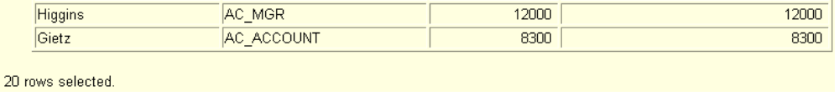
Using the CASE Expression
Facilitates conditional inquiries by doing the work of
an IF-THEN-ELSE statement:
SELECT last_name, job_id, salary,
CASE job_id WHEN 'IT_PROG' THEN 1.10*salary
WHEN 'ST_CLERK' THEN 1.15*salary
WHEN 'SA_REP' THEN 1.20*salary
ELSE salary END "REVISED_SALARY"
FROM employees;
Notes:
Using the CASE Expression
In the preceding SQL statement, the value of JOB_ID is decoded. If JOB_ID is IT_PROG, the salary increase is 10%; if JOB_ID is ST_CLERK, the salary increase is 15%; if JOB_ID is SA_REP, the salary increase is 20%. For all other job roles, there is no increase in salary.
The same statement can be written with the DECODE function.

Slide 71
The DECODE Function
Facilitates conditional inquiries by doing the work of a CASE or IF-THEN-ELSE statement:
DECODE(col|expression, search1, result1
[, search2, result2,...,]
[, default])
Notes:
The DECODE Function
The DECODE function decodes an expression in a way similar to the IF-THEN-ELSE logic used in various languages. The DECODE function decodes expression after comparing it to each search value. If the expression is the same as search, result is returned.
If the default value is omitted, a null value is returned where a search value does not match any of the result values.

Slide 72
Using the DECODE Function
SELECT last_name, job_id, salary,
DECODE(job_id, 'IT_PROG', 1.10*salary,
'ST_CLERK', 1.15*salary,
'SA_REP', 1.20*salary,
salary)
REVISED_SALARY
FROM employees;
Notes:
Using the DECODE Function
In the preceding SQL statement, the value of JOB_ID is tested. If JOB_ID is IT_PROG, the salary increase is 10%; if JOB_ID is ST_CLERK, the salary increase is 15%; if JOB_ID is SA_REP, the salary increase is 20%. For all other job roles, there is no increase in salary.
The same statement can be expressed in psuedocode as an IF-THEN-ELSE statement:
IF job_id = 'IT_PROG' THEN salary = salary*1.10
IF job_id = 'ST_CLERK' THEN salary = salary*1.15
IF job_id = 'SA_REP' THEN salart = salary*1.20
ELSE salary = salary

Slide 73
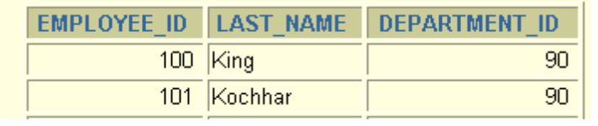
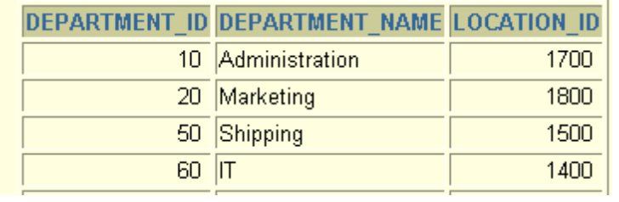
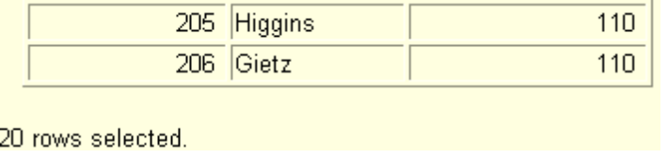
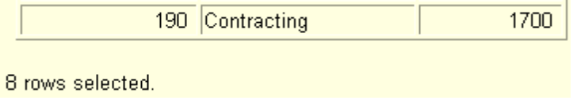
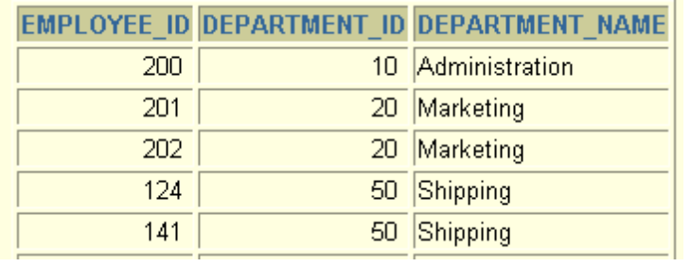
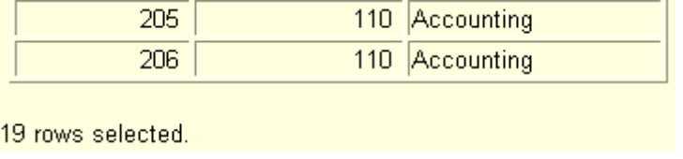
Obtaining Data from Multiple Tables
EMPLOYEES
DEPARTMENTS
Notes:
Obtaining Data from Multiple Tables
Sometimes you need to use data from more than one table. In the example, the report displays data from two separate tables.
Employee IDs exist in the EMPLOYEES table.
Department IDs exist in both the EMPLOYEES and DEPARTMENTS tables.
Location IDs exist in the DEPARTMENTS table.
To produce the report, you need to link the EMPLOYEES and DEPARTMENTS tables and access data from both of them.

Slide 74
Cartesian Products
A Cartesian product is formed when:
  A join condition is omitted
  A join condition is invalid
  All rows in the first table are joined to all rows in the second table
To avoid a Cartesian product, always include a valid join condition in a WHERE clause.
Notes:
Cartesian Products
When a join condition is invalid or omitted completely, the result is a Cartesian product, in which all combinations of rows are displayed. All rows in the first table are joined to all rows in the second table.
A Cartesian product tends to generate a large number of rows, and its result is rarely useful. You should always include a valid join condition in a WHERE clause, unless you have a specific need to combine all rows from all tables.
Cartesian products are useful for some tests when you need to generate a large number of rows to simulate a reasonable amount of data.

Slide 75
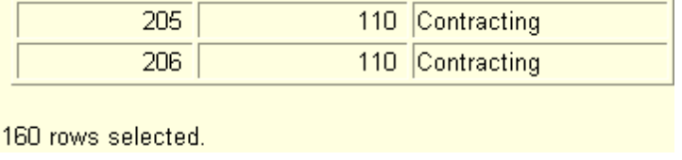
Generating a Cartesian Product
EMPLOYEES (20 rows)
DEPARTMENTS (8 rows)
Cartesian
product:
20x8=160 rows
Notes:
Generating Cartesian Products
A Cartesian product is generated if a join condition is omitted. The example in the slide displays employee last name and department name from the EMPLOYEES and DEPARTMENTS tables. Because no WHERE clause has been specified, all rows (20 rows) from the EMPLOYEES table are joined with all rows (8 rows) in the DEPARTMENTS table, thereby generating 160 rows in the output.
SELECT last_name, department_name dept_name
FROM employees, departments;
Instructor Note
Demonstration: 4_cart.sql
Purpose: To illustrate executing a Cartesian product.

Slide 76
Joining Tables Using Oracle Syntax
Use a join to query data from more than one table.
Write the join condition in the WHERE clause.
Prefix the column name with the table name when the same column name appears in more than one table.
SELECT table1.column, table2.column
FROM table1, table2
WHERE table1.column1 = table2.column2;
Notes:
Defining Joins
When data from more than one table in the database is required, a join condition is used. Rows in one table can be joined to rows in another table according to common values existing in corresponding columns, that is, usually primary and foreign key columns.
To display data from two or more related tables, write a simple join condition in the WHERE clause.
In the syntax:
table1.column denotes the table and column from which data is retrieved
table1.column1 = is the condition that joins (or relates) the tables together
table2.column2
Guidelines
When writing a SELECT statement that joins tables, precede the column name with the table name for clarity and to enhance database access.
If the same column name appears in more than one table, the column name must be prefixed with the table name.
To join n tables together, you need a minimum of n-1 join conditions. For example, to join four tables, a minimum of three joins is required. This rule may not apply if your table has a concatenated primary key, in which case more than one column is required to uniquely identify each row.
For more information, see Oracle9i SQL Reference, “SELECT.”

Slide 77
Qualifying Ambiguous
Column Names
Use table prefixes to qualify column names that are in multiple tables.
Improve performance by using table prefixes.
Distinguish columns that have identical names but reside in different tables by using column aliases.
Notes:
Qualifying Ambiguous Column Names
You need to qualify the names of the columns in the WHERE clause with the table name to avoid ambiguity. Without the table prefixes, the DEPARTMENT_ID column could be from either the DEPARTMENTS table or the EMPLOYEES table. It is necessary to add the table prefix to execute your query.
If there are no common column names between the two tables, there is no need to qualify the columns. However, using the table prefix improves performance, because you tell the Oracle Server exactly where to find the columns.
The requirement to qualify ambiguous column names is also applicable to columns that may be ambiguous in other clauses, such as the SELECT clause or the ORDER BY clause.
Instructor Note
Demonstration: 4_loc.sql
Purpose: To illustrate a SELECT clause with no aliases.

Slide 78
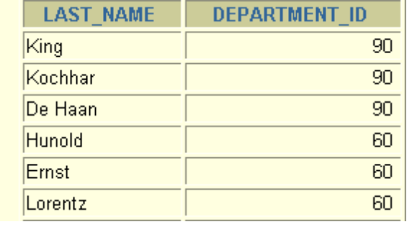
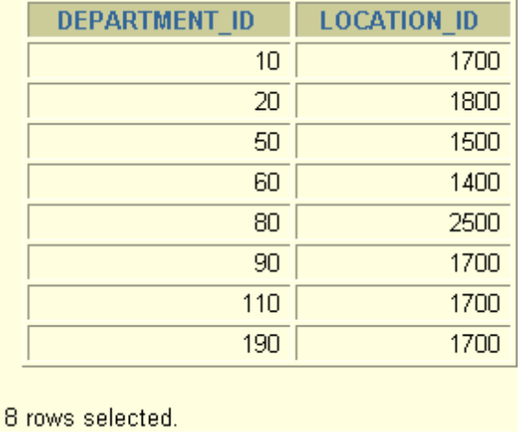
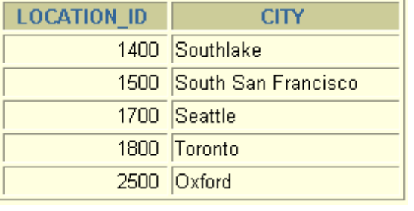
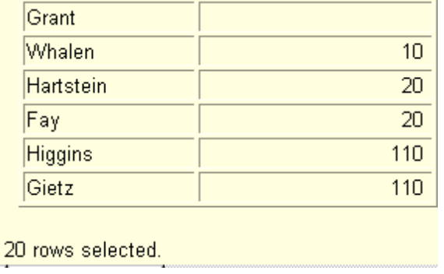
Joining More than Two Tables
EMPLOYEES
DEPARTMENTS
LOCATIONS
To join n tables together, you need a minimum of n-1
join conditions. For example, to join three tables, a
minimum of two joins is required.
Notes:
Additional Search Conditions
Sometimes you may need to join more than two tables. For example, to display the last name, the department name, and the city for each employee, you have to join the EMPLOYEES, DEPARTMENTS, and LOCATIONS tables.
SELECT e.last_name, d.department_name, l.city
FROM employees e, departments d, locations l
WHERE e.department_id = d.department_id
AND d.location_id = l.location_id;

Slide 79
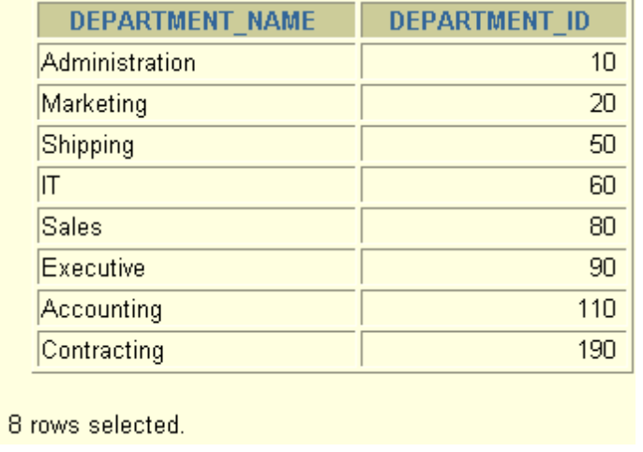
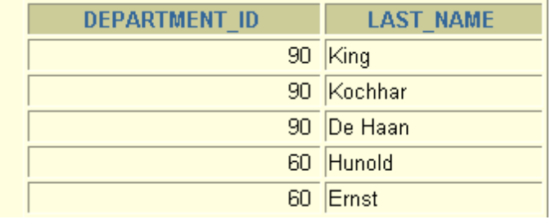
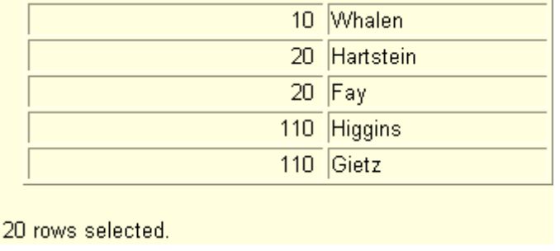
Outer Joins
DEPARTMENTS
EMPLOYEES
There are no employees in department 190.
Notes:
Returning Records with No Direct Match with Outer Joins
If a row does not satisfy a join condition, the row will not appear in the query result. For example, in the equijoin condition of EMPLOYEES and DEPARTMENTS tables, employee Grant does not appear because there is no department ID recorded for her in the EMPLOYEES table. Instead of seeing 20 employees in the result set, you see 19 records.
SELECT e.last_name, e.department_id, d.department_name
FROM employees e, departments d
WHERE e.department_id = d.department_id;

Slide 80
Outer Joins Syntax
You use an outer join to also see rows that do not meet the join condition.
The outer join operator is the plus sign (+).
SELECT table1.column, table2.column
FROM table1, table2
WHERE table1.column(+) = table2.column;
SELECT table1.column, table2.column
FROM table1, table2
WHERE table1.column = table2.column(+);
Notes:
Using Outer Joins to Return Records with No Direct Match
The missing rows can be returned if an outer join operator is used in the join condition. The operator is a plus sign enclosed in parentheses (+), and it is placed on the side of the join that is deficient in information. This operator has the effect of creating one or more null rows, to which one or more rows from the nondeficient table can be joined.
In the syntax:
table1.column = is the condition that joins (or relates) the tables together.
table2.column (+) is the outer join symbol, which can be placed on either side of the
WHERE clause condition, but not on both sides. (Place the outer
join symbol following the name of the column in the table without the matching rows.)
Instructor Note
Demonstration: 4_ejoin.sql
Purpose: To illustrate an equijoin leading to an outer join.

Slide 81
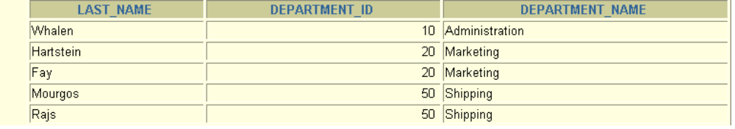
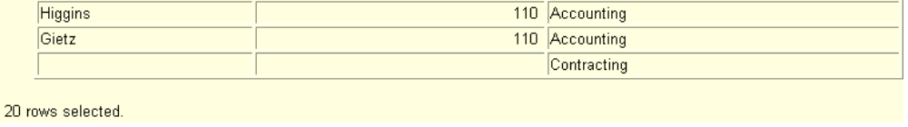
Using Outer Joins
SELECT e.last_name, e.department_id, d.department_name
FROM employees e, departments d
WHERE e.department_id(+) = d.department_id;
Notes:
Using Outer Joins
The slide example displays employee last names, department ID’s and department names. The Contracting department does not have any employees. The empty value is shown in the output shown.
Outer Join Restrictions
The outer join operator can appear on only one side of the expression: the side that has information missing. It returns those rows from one table that have no direct match in the other table.
A condition involving an outer join cannot use the IN operator or be linked to another condition by the OR operator.
Instructor Note
The UNION operator works around the issue of being able to use an outer join operator on one side of the expression. This is shown in a later lesson. The ANSI full outer join also allows you to have an outer join on both sides of the expression. It is discussed later in this lesson.
Demonstration: 4_ojoin.sql
Purpose: To illustrate an outer join.

Slide 82
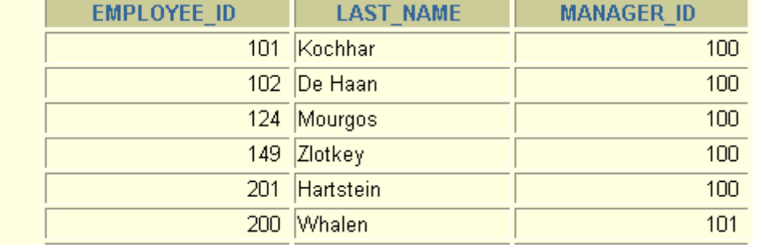



Self Joins
EMPLOYEES (WORKER)
EMPLOYEES (MANAGER)
MANAGER_ID in the WORKER table is equal to EMPLOYEE_ID in the MANAGER table.
Notes:
Joining a Table to Itself
Sometimes you need to join a table to itself. To find the name of each employee’s manager, you need to join the EMPLOYEES table to itself, or perform a self join. For example, to find the name of Whalen’s manager, you need to:
Find Whalen in the EMPLOYEES table by looking at the LAST_NAME column.
Find the manager number for Whalen by looking at the MANAGER_ID column. Whalen’s manager number is 101.
Find the name of the manager with EMPLOYEE_ID 101 by looking at the LAST_NAME column. Kochhar’s employee number is 101, so Kochhar is Whalen’s manager.
In this process, you look in the table twice. The first time you look in the table to find Whalen in the LAST_NAME column and MANAGER_ID value of 101. The second time you look in the EMPLOYEE_ID column to find 101 and the LAST_NAME column to find Kochhar.
Instructor Note
Show the data from the EMPLOYEES table and point out how each manager is also an employee.

Slide 83


Joining a Table to Itself
SELECT worker.last_name || ' works for '
|| manager.last_name
FROM employees worker, employees manager
WHERE worker.manager_id = manager.employee_id;
Notes:
Joining a Table to Itself (continued)
The example in the slide joins the EMPLOYEES table to itself. To simulate two tables in the FROM clause, there are two aliases, namely w and m, for the same table, EMPLOYEES.
In this example, the WHERE clause contains the join that means “where a worker’s manager number matches the employee number for the manager.”
Instructor Note
Point out the following to the students:
The column heading in the result of the query on the slide seems meaningless. A meaningful column alias should have been used instead.
There are only 19 rows in the output, but there are 20 rows in the EMPLOYEES table. This occurs because employee King, who is the president, does not have a manager.

Slide 84



What Are Group Functions?
Group functions operate on sets of rows to give one result per group.
EMPLOYEES
The maximum
salary in
the EMPLOYEES
table.
Notes:
Group Functions
Unlike single-row functions, group functions operate on sets of rows to give one result per group. These sets may be the whole table or the table split into groups.

Slide 85
Types of Group Functions
AVG
COUNT
MAX
MIN
SUM
Notes:
Types of Group Functions
Each of the functions accepts an argument. The following table identifies the options that you can use in the syntax:

Slide 86
Group Functions Syntax
SELECT [column,] group_function(column), ...
FROM table
[WHERE condition]
[GROUP BY column]
[ORDER BY column];
Notes:
Guidelines for Using Group Functions
DISTINCT makes the function consider only nonduplicate values; ALL makes it consider every value including duplicates. The default is ALL and therefore does not need to be specified.
The data types for the functions with an expr argument may be CHAR, VARCHAR2, NUMBER, or DATE.
All group functions ignore null values. To substitute a value for null values, use the NVL, NVL2, or COALESCE functions.
The Oracle Server implicitly sorts the result set in ascending order when using a GROUP BY clause. To override this default ordering, DESC can be used in an ORDER BY clause.
Instructor Note
Stress the use of DISTINCT and group functions ignoring null values. ALL is the default and is very rarely specified.

Slide 87
Using the AVG and SUM Functions
You can use AVG and SUM for numeric data.
SELECT AVG(salary), MAX(salary),
MIN(salary), SUM(salary)
FROM employees
WHERE job_id LIKE '%REP%';
Notes:
Group Functions
You can use AVG, SUM, MIN, and MAX functions against columns that can store numeric data. The example in the slide displays the average, highest, lowest, and sum of monthly salaries for all sales representatives.

Slide 88
Using the MIN and MAX Functions
You can use MIN and MAX for any data type.
SELECT MIN(hire_date), MAX(hire_date)
FROM employees;
Notes:
Min and Max Function
You can use the MIN and MAX functions for any data type. The slide example displays the most junior and most senior employee.
The following example displays the employee last name that is first and the employee last name that is the last in an alphabetized list of all employees.
SELECT MIN(last_name), MAX(last_name)
FROM employees;
Note: AVG, SUM, VARIANCE, and STDDEV functions can be used only with numeric data types.

Slide 89
Using the COUNT Function
COUNT(*) returns the number of rows in a table.
SELECT COUNT(*)
FROM employees
WHERE department_id = 50;
Notes:
The COUNT Function
The COUNT function has three formats:
COUNT(*)
COUNT(expr)
COUNT(DISTINCT expr)
COUNT(*) returns the number of rows in a table that satisfy the criteria of the SELECT statement, including duplicate rows and rows containing null values in any of the columns. If a WHERE clause is included in the SELECT statement, COUNT(*) returns the number of rows that satisfies the condition in the WHERE clause.
In contrast, COUNT(expr) returns the number of nonnull values in the column identified by expr.
COUNT(DISTINCT expr) returns the number of unique, non-null values in the column identified by expr.
The example in the slide displays the number of employees in department 50.
Instructor Note
Demonstration: 5_count1.sql, 5_count2.sql
Purpose: To illustrate using the COUNT(*) and COUNT(expr) functions.

Slide 90
Using the COUNT Function
COUNT(expr) returns the number of rows with non-null values for the expr.
Display the number of department values in the EMPLOYEES table, excluding the null values.
SELECT COUNT(commission_pct)
FROM employees
WHERE department_id = 80;
Notes:
Using the COUNT Function
The example in the slide displays the number of employees in department 80 who can earn a commission.
Example
Display the number of department values in the EMPLOYEES table.
SELECT COUNT(department_id)
FROM employees;

Slide 91
Using the DISTINCT Keyword
COUNT(DISTINCT expr) returns the number of distinct nonnull values of the expr.
Display the number of distinct department values in the EMPLOYEES table.
SELECT COUNT(DISTINCT department_id)
FROM employees;
Notes:
Using the DISTINCT Keyword
Use the DISTINCT keyword to suppress the counting of any duplicate values within a column.
The example in the slide displays the number of distinct department values in the EMPLOYEES table.

Slide 92
Group Functions and Null Values
Group functions ignore null values in the column.
SELECT AVG(commission_pct)
FROM employees;
Notes:
Group Functions and Null Values
All group functions ignore null values in the column. In the example in the slide, the average is calculated based only on the rows in the table where a valid value is stored in the COMMISSION_PCT column. The average is calculated as the total commission paid to all employees divided by the number of employees receiving a commission.

Slide 93
Using the NVL Function with Group Functions
The NVL function forces group functions to include
null values.
SELECT AVG(NVL(commission_pct, 0))
FROM employees;
Notes:
Using the NVL Function with Group Functions
The NVL function forces group functions to include null values. In the example in the slide, the average is calculated based on all rows in the table, regardless of whether null values are stored in the COMMISSION_PCT column. The average is calculated as the total commission paid to all employees divided by the total number of employees in the company.

Slide 94



Creating Groups of Data
EMPLOYEES
4400
9500
The
average
salary
in
EMPLOYEES
table
for each
department.
3500
6400
Notes:
Creating Groups of Data
Until now, all group functions have treated the table as one large group of information. At times, you need to divide the table of information into smaller groups. This can be done by using the GROUP BY clause.

Slide 95
Creating Groups of Data:
GROUP BY Clause Syntax
SELECT column, group_function(column)
FROM table
[WHERE condition]
[GROUP BY group_by_expression]
[ORDER BY column];
Divide rows in a table into smaller groups by using the
GROUP BY clause.
Notes:
The GROUP BY Clause
You can use the GROUP BY clause to divide the rows in a table into groups. You can then use the group functions to return summary information for each group.
In the syntax:
group_by_expression specifies columns whose values determine the basis for
grouping rows
Guidelines
If you include a group function in a SELECT clause, you cannot select individual results as well, unless the individual column appears in the GROUP BY clause. You receive an error message if you fail to include the column list in the GROUP BY clause.
Using a WHERE clause, you can exclude rows before dividing them into groups.
You must include the columns in the GROUP BY clause.
You cannot use a column alias in the GROUP BY clause.
By default, rows are sorted by ascending order of the columns included in the GROUP BY list. You can override this by using the ORDER BY clause.

Slide 96

Using the GROUP BY Clause
All columns in the SELECT list that are not in group
functions must be in the GROUP BY clause.
SELECT department_id, AVG(salary)
FROM employees
GROUP BY department_id;
Notes:
Using the GROUP BY Clause
When using the GROUP BY clause, make sure that all columns in the SELECT list that are not group functions are included in the GROUP BY clause. The example in the slide displays the department number and the average salary for each department. Here is how this SELECT statement, containing a GROUP BY clause, is evaluated:
The SELECT clause specifies the columns to be retrieved:
The department number column in the EMPLOYEES table
The average of all the salaries in the group you specified in the GROUP BY clause
The FROM clause specifies the tables that the database must access: the EMPLOYEES table.
The WHERE clause specifies the rows to be retrieved. Because there is no WHERE clause, all rows are retrieved by default.
The GROUP BY clause specifies how the rows should be grouped. The rows are being grouped by department number, so the AVG function that is being applied to the salary column will calculate the average salary for each department.
Instructor Note
Group results are sorted implicitly, on the grouping column. You can use ORDER BY to specify a different sort order, remembering to use only group functions, or the grouping column.

Slide 97

Using the GROUP BY Clause
The GROUP BY column does not have to be in the
SELECT list.
SELECT AVG(salary)
FROM employees
GROUP BY department_id;
Notes:
Using the GROUP BY Clause (continued)
The GROUP BY column does not have to be in the SELECT clause. For example, the SELECT statement on the slide displays the average salaries for each department without displaying the respective department numbers. Without the department numbers, however, the results do not look meaningful.
You can use the group function in the ORDER BY clause.
SELECT department_id, AVG(salary)
FROM employees
GROUP BY department_id
ORDER BY AVG(salary);
Instructor Note
Demonstrate the query with and without the DEPARTMENT_ID column in the SELECT statement.

Slide 98

Using the GROUP BY Clause on Multiple Columns
SELECT department_id dept_id, job_id, SUM(salary)
FROM employees
GROUP BY department_id, job_id;
Notes:
Using the Group By Clause on Multiple Columns
You can return summary results for groups and subgroups by listing more than one GROUP BY column. You can determine the default sort order of the results by the order of the columns in the GROUP BY clause. Here is how the SELECT statement on the slide, containing a GROUP BY clause, is evaluated:
The SELECT clause specifies the column to be retrieved:
Department number in the EMPLOYEES table
Job ID in the EMPLOYEES table
The sum of all the salaries in the group that you specified in the GROUP BY clause
The FROM clause specifies the tables that the database must access: the EMPLOYEES table
The GROUP BY clause specifies how you must group the rows:
First, the rows are grouped by department number
Second, within the department number groups, the rows are grouped by job ID
So the SUM function is being applied to the salary column for all job IDs within each department number group.

Slide 99



Excluding Group Results
EMPLOYEES
The maximum
salary
per department
when it is
greater than
$10,000.
Notes:
Restricting Group Results
In the same way that you use the WHERE clause to restrict the rows that you select, you use the HAVING clause to restrict groups. To find the maximum salary of each department, but show only the departments that have a maximum salary of more than $10,000, you need to do the following:
1. Find the average salary for each department by grouping by department number.
2. Restrict the groups to those departments with a maximum salary greater than $10,000.

Slide 100
Excluding Group Results: The HAVING Clause
Use the HAVING clause to restrict groups:
1. Rows are grouped.
2. The group function is applied.
3. Groups matching the HAVING clause are displayed.
SELECT column, group_function
FROM table
[WHERE condition]
[GROUP BY group_by_expression]
[HAVING group_condition]
[ORDER BY column];
Notes:
The HAVING Clause
You use the HAVING clause to specify which groups are to be displayed, and thus, you further restrict the groups on the basis of aggregate information.
In the syntax:
group_condition restricts the groups of rows returned to those groups for which
the specified condition is true
The Oracle Server performs the following steps when you use the HAVING clause:
1. Rows are grouped.
2. The group function is applied to the group.
3. The groups that match the criteria in the HAVING clause are displayed.
The HAVING clause can precede the GROUP BY clause, but it is recommended that you place the GROUP BY clause first because that is more logical. Groups are formed and group functions are calculated before the HAVING clause is applied to the groups in the SELECT list.
Instructor Note
The Oracle Server evaluates the clauses in the following order:
If the statement contains a WHERE clause, the server establishes the candidate rows.
The server identifies the groups specified in the GROUP BY clause.
The HAVING clause further restricts result groups that do not meet the group criteria in the HAVING clause.

Slide 101

Using the HAVING Clause
SELECT department_id, MAX(salary)
FROM employees
GROUP BY department_id
HAVING MAX(salary)>10000;
Notes:
Using the HAVING Clause
The example in the slide displays department numbers and maximum salaries for those departments whose maximum salary is greater than $10,000.
You can use the GROUP BY clause without using a group function in the SELECT list.
If you restrict rows based on the result of a group function, you must have a GROUP BY clause as well as the HAVING clause.
The following example displays the department numbers and average salaries for those departments whose maximum salary is greater than $10,000:
SELECT department_id, AVG(salary)
FROM employees
GROUP BY department_id
HAVING max(salary)>10000;

Slide 102

Using the HAVING Clause
SELECT job_id, SUM(salary) PAYROLL
FROM employees
WHERE job_id NOT LIKE '%REP%'
GROUP BY job_id
HAVING SUM(salary) > 13000
ORDER BY SUM(salary);
Notes:
Using the HAVING Clause (continued)
The example in the slide displays the job ID and total monthly salary for each job with a total payroll exceeding $13,000. The example excludes sales representatives and sorts the list by the total monthly salary.
Instructor Note
Demonstration: 5_job1.sql, 5_job2.sql
Purpose: To illustrate using a WHERE clause to restrict rows by JOB_ID and using a HAVING clause to restrict groups by SUM(SALARY).

Slide 103
Nesting Group Functions
Display the maximum average salary.
SELECT MAX(AVG(salary))
FROM employees
GROUP BY department_id;
Notes:
Nesting Group Functions
Group functions can be nested to a depth of two. The example in the slide displays the maximum average salary.

Slide 104
GROUP BY with ROLLUP and
CUBE Operators
Use ROLLUP or CUBE with GROUP BY to produce superaggregate rows by cross-referencing columns.
ROLLUP grouping produces a results set containing the regular grouped rows and the subtotal values.
CUBE grouping produces a results set containing the rows from ROLLUP and cross-tabulation rows.
Notes:
GROUP BY with the ROLLUP and CUBE Operators
You specify ROLLUP and CUBE operators in the GROUP BY clause of a query. ROLLUP grouping produces a results set containing the regular grouped rows and subtotal rows. The CUBE operation in the GROUP BY clause groups the selected rows based on the values of all possible combinations of expressions in the specification and returns a single row of summary information for each group. You can use the CUBE operator to produce cross-tabulation rows.
Note: When working with ROLLUP and CUBE, make sure that the columns following the GROUP BY clause have meaningful, real-life relationships with each other; otherwise the operators return irrelevant information.
The ROLLUP and CUBE operators are available only in Oracle8i and later releases.

Slide 105
ROLLUP Operator
SELECT [column,] group_function(column). . .
FROM table
[WHERE condition]
[GROUP BY [ROLLUP] group_by_expression]
[HAVING having_expression];
[ORDER BY column];
ROLLUP is an extension to the GROUP BY clause.
Use the ROLLUP operation to produce cumulative aggregates such as subtotals.
Notes:
The ROLLUP Operator
The ROLLUP operator delivers aggregates and superaggregates for expressions within a GROUP BY statement. The ROLLUP operator can be used by report writers to extract statistics and summary information from results sets. The cumulative aggregates can be used in reports, charts, and graphs.
The ROLLUP operator creates groupings by moving in one direction, from right to left, along the list of columns specified in the GROUP BY clause. It then applies the aggregate function to these groupings.
Note: To produce subtotals in n dimensions (that is, n columns in the GROUP BY clause) without a ROLLUP operator, n+1 SELECT statements must be linked with UNION ALL. This makes the query execution inefficient, because each of the SELECT statements causes table access. The ROLLUP operator gathers its results with just one table access. The ROLLUP operator is useful if there are many columns involved in producing the subtotals.

Slide 106

ROLLUP Operator Example
SELECT department_id, job_id,
FROM employees
WHERE department_id < 60
GROUP BY
SUM(salary)
ROLLUP(department_id, job_id);
1
2
3
Notes:
Example of a ROLLUP Operator
In the example in the slide:
Total salaries for every job ID within a department for those departments whose department ID is less than 60 are displayed by the GROUP BY clause (labeled 1)
The ROLLUP operator displays:
Total salary for those departments whose department ID is less than 60 (labeled 2)
Total salary for all departments whose department ID is less than 60, irrespective of the job IDs (labeled 3)
All rows indicated as 1 are regular rows and all rows indicated as 2 and 3 are superaggregate rows.
The ROLLUP operator creates subtotals that roll up from the most detailed level to a grand total, following the grouping list specified in the GROUP BY clause. First it calculates the standard aggregate values for the groups specified in the GROUP BY clause (in the example, the sum of salaries grouped on each job within a department). Then it creates progressively higher-level subtotals, moving from right to left through the list of grouping columns. (In the preceding example, the sum of salaries for each department is calculated, followed by the sum of salaries for all departments.)
Given n expressions in the ROLLUP operator of the GROUP BY clause, the operation results in n + 1 = 2 + 1 = 3 groupings.
Rows based on the values of the first n expressions are called rows or regular rows and the others are called superaggregate rows.

Slide 107
CUBE Operator
SELECT [column,] group_function(column). . .
FROM table
[WHERE condition]
[GROUP BY [CUBE] group_by_expression]
[HAVING having_expression];
[ORDER BY column];
CUBE is an extension to the GROUP BY clause.
You can use the CUBE operator to produce cross-tabulation values with a single SELECT statement.
Notes:
The CUBE Operator
The CUBE operator is an additional switch in the GROUP BY clause in a SELECT statement. The CUBE operator can be applied to all aggregate functions, including AVG, SUM, MAX, MIN, and COUNT. It is used to produce results sets that are typically used for cross-tabular reports. While ROLLUP produces only a fraction of possible subtotal combinations, CUBE produces subtotals for all possible combinations of groupings specified in the GROUP BY clause, and a grand total.
The CUBE operator is used with an aggregate function to generate additional rows in a results set. Columns included in the GROUP BY clause are cross-referenced to produce a superset of groups. The aggregate function specified in the select list is applied to these groups to produce summary values for the additional superaggregate rows. The number of extra groups in the results set is determined by the number of columns included in the GROUP BY clause.
In fact, every possible combination of the columns or expressions in the GROUP BY clause is used to produce superaggregates. If you have n columns or expressions in the GROUP BY clause, there will be 2^{n} possible superaggregate combinations. Mathematically, these combinations form an
n-dimensional cube, which is how the operator got its name.
By using application or programming tools, these superaggregate values can then be fed into charts and graphs that convey results and relationships visually and effectively.

Slide 108

CUBE Operator: Example
SELECT department_id, job_id, SUM(salary)
FROM employees
WHERE department_id < 60
GROUP BY CUBE (department_id, job_id);
1
2
3
4
Notes:
Example of a CUBE Operator
The output of the SELECT statement in the example can be interpreted as follows:
The total salary for every job within a department (for those departments whose department ID is less than 50) is displayed by the GROUP BY clause (labeled 1)
The total salary for those departments whose department ID is less than 50 (labeled 2)
The total salary for every job irrespective of the department (labeled 3)
Total salary for those departments whose department ID is less than 50, irrespective of the job titles (labeled 4)
In the preceding example, all rows indicated as 1 are regular rows, all rows indicated as 2 and 4 are superaggregate rows, and all rows indicated as 3 are cross-tabulation values.
The CUBE operator has also performed the ROLLUP operation to display the subtotals for those departments whose department ID is less than 50 and the total salary for those departments whose department ID is less than 50, irrespective of the job titles. Additionally, the CUBE operator displays the total salary for every job irrespective of the department.
Note: Similar to the ROLLUP operator, producing subtotals in n dimensions (that is, n columns in the GROUP BY clause) without a CUBE operator requires 2^{n} SELECT statements to be linked with UNION ALL. Thus, a report with three dimensions requires 2³ = 8 SELECT statements to be linked with UNION ALL.

Slide 109
GROUPING SETS
GROUPING SETS are a further extension of the
GROUP BY clause.
You can use GROUPING SETS to define multiple groupings in the same query.
The Oracle Server computes all groupings specified in the GROUPING SETS clause and combines the results of individual groupings with a UNION ALL operation.
Grouping set efficiency:
  Only one pass over the base table is required.
  There is no need to write complex UNION statements.
  The more elements the GROUPING SETS have, the higher the performance benefit is.
Notes:
GROUPING SETS
GROUPING SETS are a further extension of the GROUP BY clause that let you specify multiple groupings of data. Doing so facilitates efficient aggregation and hence facilitates analysis of data across multiple dimensions.
A single SELECT statement can now be written using GROUPING SETS to specify various groupings (that can also include ROLLUP or CUBE operators), rather than multiple SELECT statements combined by UNION ALL operators. For example, you can say:
SELECT department_id, job_id, manager_id, AVG(salary)
FROM employees
GROUP BY
GROUPING SETS
((department_id, job_id, manager_id),
(department_id, manager_id),(job_id, manager_id));
This statement calculates aggregates over three groupings:
(department_id, job_id, manager_id), (department_id, manager_id)
and (job_id, manager_id)
Without this enhancement in Oracle9i, multiple queries combined together with UNION ALL are required to get the output of the preceding SELECT statement. A multiquery approach is inefficient, for it requires multiple scans of the same data.

Slide 110

GROUPING SETS: Example
SELECT department_id, job_id, manager_id,avg(salary)
FROM employees
GROUP BY
GROUPING SETS
((department_id,job_id), (job_id,manager_id));
1
2
Notes:
GROUPING SETS: Example
The query in the slide calculates aggregates over two groupings. The table is divided into the following groups:
Department ID, Job ID
Job ID, Manager ID
The average salaries for each of these groups are calculated. The results set displays average salary for each of the two groups.
In the output, the group marked as 1 can be interpreted as:
The average salary of all employees with the job ID AD_ASST in the department 10 is 4400.
The average salary of all employees with the job ID MK_MAN in the department 20 is 13000.
The average salary of all employees with the job ID MK_REP in the department 20 is 6000.
The average salary of all employees with the job ID ST_CLERK in the department 50 is 2925 and so on.

Slide 111
Using a Subquery to Solve a Problem
Who has a salary greater than Abel’s?
Main Query:
Which employees have salaries greater than Abel’s salary?
?
Subquery:
?
What is Abel’s salary?
Notes:
Using a Subquery to Solve a Problem
Suppose you want to write a query to find out who earns a salary greater than Abel’s salary.
To solve this problem, you need two queries: one to find what Abel earns, and a second query to find who earns more than that amount.
You can solve this problem by combining the two queries, placing one query inside the other query.
The inner query, also called the subquery, returns a value that is used by the outer query or the main query. Using a subquery is equivalent to performing two sequential queries and using the result of the first query as the search value in the second query.
Instructor Note
This lesson concentrates on noncorrelated subqueries. A later lesson covers correlated subqueries.

Slide 112
Subquery Syntax
SELECT select_list
FROM table
WHERE expr operator
(SELECT select_list
FROM table);
The subquery (inner query) executes once before the main query.
The result of the subquery is used by the main query (outer query).
Notes:
Subqueries
A subquery is a SELECT statement that is embedded in a clause of another SELECT statement. You can build powerful statements out of simple ones by using subqueries. They can be very useful when you need to select rows from a table with a condition that depends on the data in the table itself.
You can place the subquery in a number of SQL clauses, including:
The WHERE clause
The HAVING clause
The FROM clause
In the syntax:
operator includes a comparison condition such as >, =, or IN
Note: Comparison conditions fall into two classes: single-row operators (>, =, >=, <, <>, <=) and multiple-row operators (IN, ANY, ALL).
The subquery is often referred to as a nested SELECT, sub-SELECT, or inner SELECT statement. The subquery generally executes first, and its output is used to complete the query condition for the main or outer query.
Instructor Note
Additionally, subqueries can be placed in the CREATE VIEW statement, CREATE TABLE statement, UPDATE statement, INTO clause of an INSERT statement, and SET clause of an UPDATE statement.

Slide 113

Using a Subquery
SELECT last_name
FROM employees
WHERE salary >
(SELECT salary
FROM employees
WHERE last_name = 'Abel');
11000
Notes:
Using a Subquery
In the slide, the inner query determines the salary of employee Abel. The outer query takes the result of the inner query and uses this result to display all the employees who earn more than this amount.
Instructor Note
Execute the subquery (inner query) on its own first to show the value that the subquery returns. Then execute the outer query using the result returned by the inner query. Finally, execute the entire query (containing the subquery), and show that the result is the same.

Slide 114
Types of Subqueries
Single-row subquery
Main query
returns
Subquery
ST_CLERK
  Multiple-row subquery
Main query
returns
ST_CLERK
SA_MAN
Subquery
Notes:
Types of Subqueries
Single-row subqueries: Queries that return only one row from the inner SELECT statement
Multiple-row subqueries: Queries that return more than one row from the inner SELECT statement
Note: There are also multiple-column subqueries: queries that return more than one column from the inner SELECT statement. This is discussed in a subsequent lesson.
Instructor Note
Multiple column subqueries are also available. They are discussed later in the course

Slide 115
Single-Row Subqueries
Return only one row
Use single-row comparison operators
Operator
=
>
>=
<
<=
<>
Meaning
Equal to
Greater than
Greater than or equal to
Less than
Less than or equal to
Not equal to
Notes:
Single-Row Subqueries
A single-row subquery is one that returns one row from the inner SELECT statement. This type of subquery uses a single-row operator. The slide gives a list of single-row operators.
Example
Display the employees whose job ID is the same as that of employee 141.
SELECT last_name, job_id
FROM employees
WHERE job_id =
(SELECT job_id
FROM employees
WHERE employee_id = 141);

Slide 116
Executing Single-Row Subqueries
SELECT last_name, job_id, salary
FROM employees
WHERE job_id =
(SELECT job_id
FROM employees
WHERE employee_id = 141)
AND salary >
(SELECT salary
FROM employees
WHERE employee_id = 143);
ST_CLERK
2600
Notes:
Executing Single-Row Subqueries
A SELECT statement can be considered as a query block. The example on the slide displays employees whose job ID is the same as that of employee 141 and whose salary is greater than that of employee 143.
The example consists of three query blocks: the outer query and two inner queries. The inner query blocks are executed first, producing the query results ST_CLERK and 2600, respectively. The outer query block is then processed and uses the values returned by the inner queries to complete its search conditions.
Both inner queries return single values (ST_CLERK and 2600, respectively), so this SQL statement is called a single-row subquery.
Note: The outer and inner queries can get data from different tables.

Slide 117
Using Group Functions in a Subquery
SELECT last_name, job_id, salary
FROM employees
WHERE salary =
(SELECT MIN(salary)
FROM employees);
2500
Notes:
Using Group Functions in a Subquery
You can display data from a main query by using a group function in a subquery to return a single row. The subquery is in parentheses and is placed after the comparison condition.
The example on the slide displays the employee last name, job ID, and salary of all employees whose salary is equal to the minimum salary. The MIN group function returns a single value (2500) to the outer query.

Slide 118
The HAVING Clause with Subqueries
The Oracle Server executes subqueries first.
The Oracle Server returns results into the HAVING clause of the main query.
SELECT department_id, MIN(salary)
FROM employees
GROUP BY department_id
HAVING MIN(salary) >
(SELECT MIN(salary)
FROM employees
WHERE department_id = 50);
2500
Notes:
The HAVING Clause with Subqueries
You can use subqueries not only in the WHERE clause, but also in the HAVING clause. The Oracle Server executes the subquery, and the results are returned into the HAVING clause of the main query.
The SQL statement on the slide displays all the departments that have a minimum salary greater than that of department 50.
Example
Find the job with the lowest average salary.
SELECT job_id, AVG(salary)
FROM employees
GROUP BY job_id
HAVING AVG(salary) = (SELECT MIN(AVG(salary))
FROM employees
GROUP BY job_id);

Slide 119
What Is Wrong with This Statement?
SELECT employee_id, last_name
FROM employees
WHERE salary =
(SELECT MIN(salary)
FROM employees
GROUP BY department_id);
Single-row operator with
multiple-row subquery
ERROR at line 4:
ORA-01427: single-row subquery returns more than
one row
Notes:
Errors with Subqueries
One common error with subqueries is more than one row returned for a single-row subquery.
In the SQL statement in the slide, the subquery contains a GROUP BY clause, which implies that the subquery will return multiple rows, one for each group it finds. In this case, the result of the subquery will be 4400, 6000, 2500, 4200, 7000, 17000, and 8300.
The outer query takes the results of the subquery (4400, 6000, 2500, 4200, 7000, 17000, 8300) and uses these results in its WHERE clause. The WHERE clause contains an equal (=) operator, a single-row comparison operator expecting only one value. The = operator cannot accept more than one value from the subquery and hence generates the error.
To correct this error, change the = operator to IN.

Slide 120
Will This Statement Return Rows?
SELECT last_name, job_id
FROM employees
WHERE job_id =
(SELECT job_id
FROM employees
WHERE last_name = 'Haas');
Subquery returns no values
no rows selected
Notes:
Problems with Subqueries
A common problem with subqueries is that no rows are returned by the inner query.
In the SQL statement on the slide, the subquery contains a WHERE clause. Presumably, the intention is to find the employee whose name is Haas. The statement is correct but selects no rows when executed.
There is no employee named Haas. So the subquery returns no rows. The outer query takes the results of the subquery (null) and uses these results in its WHERE clause. The outer query finds no employee with a job ID equal to null, and so returns no rows. If a job existed with a value of null, the row is not returned because comparison of two null values yields a null, hence the WHERE condition is not true.

Slide 121
The SET Operators
A
B
A
B
UNION/UNION ALL
A
B
INTERSECT
A
B
MINUS
Notes:
The SET Operators
The SET operators combine the results of two or more component queries into one result. Queries containing SET operators are called compound queries.
All SET operators have equal precedence. If a SQL statement contains multiple SET operators, the Oracle server evaluates them from left (top) to right (bottom) if no parentheses explicitly specify another order. You should use parentheses to specify the order of evaluation explicitly in queries that use the INTERSECT operator with other SET operators.
Note: In the slide, the light color (grey) in the diagram represents the query result.
Instructor Note
The INTERSECT and MINUS operators are not ANSI SQL-99 compliant. They are Oracle-specific.

Slide 122
The UNION SET Operator
A
B
The UNION operator returns results from both queries
after eliminating duplications.
Notes:
The UNION SET Operator
The UNION operator returns all rows selected by either query. Use the UNION operator to return all rows from multiple tables and eliminate any duplicate rows.
Guidelines
The number of columns and the data types of the columns being selected must be identical in all the SELECT statements used in the query. The names of the columns need not be identical.
UNION operates over all of the columns being selected.
NULL values are not ignored during duplicate checking.
The IN operator has a higher precedence than the UNION operator.
By default, the output is sorted in ascending order of the first column of the SELECT clause.
Instructor Note
To illustrate the UNION SET operator, run the script demo\15_union1.sql.
Point out that the output is sorted in ascending order of the first column of the SELECT clause.

Slide 123

Using the UNION Operator
Display the current and previous job details of all
employees. Display each employee only once.
SELECT employee_id, job_id
FROM employees
UNION
SELECT employee_id, job_id
FROM job_history;
Notes:
Using the UNION SET Operator
The UNION operator eliminates any duplicate records. If there are records that occur both in the EMPLOYEES and the JOB_HISTORY tables and are identical, the records will be displayed only once. Observe in the output shown on the slide that the record for the employee with the EMPLOYEE_ID 200 appears twice as the JOB_ID is different in each row.
Consider the following example:
SELECT employee_id, job_id, department_id
FROM employees
UNION
SELECT employee_id, job_id, department_id
FROM job_history;

Slide 124
The UNION ALL Operator
A
B
The UNION ALL operator returns results from both queries including all duplications.
Notes:
The UNION ALL Operator
Use the UNION ALL operator to return all rows from multiple queries.
Guidelines
Unlike UNION, duplicate rows are not eliminated and the output is not sorted by default.
The DISTINCT keyword cannot be used.
Note: With the exception of the above, the guidelines for UNION and UNION ALL are the same.
Instructor Note
To illustrate the UNION ALL operator, run the script demo\15_union2.sql.

Slide 125

Using the UNION ALL Operator
Display the current and previous departments of
all employees.
SELECT employee_id, job_id, department_id
FROM employees
UNION ALL
SELECT employee_id, job_id, department_id
FROM job_history
ORDER BY employee_id;
Notes:
The UNION ALL Operator (continued)
In the example, 30 rows are selected. The combination of the two tables totals to 30 rows. The UNION ALL operator does not eliminate duplicate records. The duplicate records are highlighted in the output shown in the slide. UNION returns all distinct rows selected by either query. UNION ALL returns all rows selected by either query, including all duplicates. Consider the query on the slide, now written with the UNION clause:
SELECT employee_id, job_id,department_id
FROM employees
UNION
SELECT employee_id, job_id,department_id
FROM job_history
ORDER BY employee_id;
The preceding query returns 29 rows. This is because it eliminates the following row (as it is a duplicate):
Instructor Note
Note that this is the example from page 8.

Slide 126
The INTERSECT Operator
A
B
The INTERSECT operator returns results that are common to both queries.
Notes:
The INTERSECT Operator
Use the INTERSECT operator to return all rows common to multiple queries.
Guidelines
The number of columns and the data types of the columns being selected by the SELECT statements in the queries must be identical in all the SELECT statements used in the query. The names of the columns need not be identical.
Reversing the order of the intersected tables does not alter the result.
INTERSECT does not ignore NULL values.
Instructor Note
To illustrate the INTERSECT SET operator, run the script demo\15_inters.sql.

Slide 127
Using the INTERSECT Operator
Display the employee IDs and job IDs of employees who are currently in a job title that they have held once before during their tenure with the company
SELECT employee_id, job_id
FROM employees
INTERSECT
SELECT employee_id, job_id
FROM job_history;
Notes:
The INTERSECT Operator (continued)
In the example in this slide, the query returns only the records that have the same values in the selected columns in both tables.
What will be the results if you add the DEPARTMENT_ID column to the SELECT statement from the EMPLOYEES table and add the DEPARTMENT_ID column to the SELECT statement from the JOB_HISTORY table and run this query? The results may be different because of the introduction of another column whose values may or may not be duplicates.
Example
SELECT employee_id, job_id, department_id
FROM employees
INTERSECT
SELECT employee_id, job_id, department_id
FROM job_history;
Employee 200 is no longer part of the results because the EMPLOYEES.DEPARTMENT_ID value is different from the JOB_HISTORY.DEPARTMENT_ID value.

Slide 128
The MINUS Operator
A
B
The MINUS operator returns rows from the first query
that are not present in the second query.
Notes:
The MINUS Operator
Use the MINUS operator to return rows returned by the first query that are not present in the second query (the first SELECT statement MINUS the second SELECT statement).
Guidelines
The number of columns and the data types of the columns being selected by the SELECT statements in the queries must be identical in all the SELECT statements used in the query. The names of the columns need not be identical.
All of the columns in the WHERE clause must be in the SELECT clause for the MINUS operator to work.
Instructor Note
To illustrate the MINUS operator, run the script demo\15_minus.sql.

Slide 129

The MINUS Operator
Display the employee IDs of those employees who have not changed their jobs even once.
SELECT employee_id
FROM employees
MINUS
SELECT employee_id
FROM job_history;
Notes:
The MINUS Operator (continued)
In the example in the slide, the employee IDs in the JOB_HISTORY table are subtracted from those in the EMPLOYEES table. The results set displays the employees remaining after the subtraction; they are represented by rows that exist in the EMPLOYEES table but do not exist in the JOB_HISTORY table. These are the records of the employees who have not changed their jobs even once.

Slide 130
SET Operator Guidelines
The expressions in the SELECT lists must match in number and data type.
Parentheses can be used to alter the sequence of execution.
The ORDER BY clause:
  Can appear only at the very end of the statement
  Will accept the column name, aliases from the first SELECT statement, or the positional notation
Notes:
SET Operator Guidelines
The expressions in the select lists of the queries must match in number and datatype. Queries that use UNION, UNION ALL, INTERSECT, and MINUS SET operators in their WHERE clause must have the same number and type of columns in their SELECT list. For example:
SELECT employee_id, department_id
FROM employees
WHERE (employee_id, department_id)
IN (SELECT employee_id, department_id
FROM employees
UNION
SELECT employee_id, department_id
FROM job_history);
The ORDER BY clause:
Can appear only at the very end of the statement
Will accept the column name, an alias, or the positional notation
The column name or alias, if used in an ORDER BY clause, must be from the first SELECT list.
SET operators can be used in subqueries.
Instructor Note
You might want to mention that the ORDER BY clause accepts the column name only if the column has the same name from both queries.

Slide 131
The Oracle Server and SET Operators
Duplicate rows are automatically eliminated except in UNION ALL.
Column names from the first query appear in the result.
The output is sorted in ascending order by default except in UNION ALL.
Notes:
The Oracle Server and SET Operators
When a query uses SET operators, the Oracle Server eliminates duplicate rows automatically except in the case of the UNION ALL operator. The column names in the output are decided by the column list in the first SELECT statement. By default, the output is sorted in ascending order of the first column of the SELECT clause.
The corresponding expressions in the select lists of the component queries of a compound query must match in number and datatype. If component queries select character data, the data type of the return values are determined as follows:
If both queries select values of datatype CHAR, the returned values have datatype CHAR.
If either or both of the queries select values of datatype VARCHAR2, the returned values
have datatype VARCHAR2.
Instructor Note
You might want to mention that the output is sorted in ascending order of the first column, then the second column, and so on, of the SELECT clause.

Slide 132


Matching the SELECT Statements
Using the UNION operator, display the department ID,
location, and hire date for all employees.
SELECT department_id, TO_NUMBER(null) location, hire_date
FROM employees
UNION
SELECT department_id, location_id, TO_DATE(null)
FROM departments;
Notes:
Matching the SELECT Statements
As the expressions in the select lists of the queries must match in number , you can use dummy columns and the data type conversion functions to comply with this rule. In the slide, the name location is given as the dummy column heading. The TO_NUMBER function is used in the first query to match the NUMBER data type of the LOCATION_ID column retrieved by the second query. Similarly, the TO_DATE function in the second query is used to match the DATE datatype of the HIRE_DATE column retrieved by the second query.
Instructor Note
Demonstration: demo\15_union3.sql, demo\15_dummy.sql
Purpose: The demonstration l15union3.sql illustrates using conversion functions while matching columns in the two select lists. The demonstration 15_dummy.sql uses dummy columns in order to match the select lists. For the 15_dummy.sql, run the script, then uncomment the REMARKS, add ORDER BY 2, and rerun.
You might want to mention that the conversion functions in the code shown on the slide are not mandatory. The code will work fine even without the conversion functions, but it is recommended to explicitly convert values for performance benefits.

Slide 133

Matching the SELECT Statement
Using the UNION operator, display the employee ID, job ID, and salary of all employees.
SELECT employee_id, job_id,salary
FROM employees
UNION
SELECT employee_id, job_id,0
FROM job_history;
Notes:
Matching the SELECT Statement: Example
The EMPLOYEES and JOB_HISTORY tables have several columns in common; for example, EMPLOYEE_ID, JOB_ID and DEPARTMENT_ID. But what if you want the query to display the EMPLOYEE_ID, JOB_ID, and SALARY using the UNION operator, knowing that the salary exists only in the, EMPLOYEES table?
The code example in the slide matches the EMPLOYEE_ID and the JOB_ID columns in the EMPLOYEES and in the JOB_HISTORY tables. A literal value of 0 is added to the JOB_HISTORY SELECT statement to match the numeric SALARY column in the EMPLOYEES SELECT statement.
In the preceding results, each row in the output that corresponds to a record from the JOB_HISTORY table contains a 0 in the SALARY column.

Slide 134

Sample Data from the EMPLOYEES Table
Notes:
Sample Data from the EMPLOYEES Table
Using hierarchical queries, you can retrieve data based on a natural hierarchical relationship between rows in a table. A relational database does not store records in a hierarchical way. However, where a hierarchical relationship exists between the rows of a single table, a process called tree walking enables the hierarchy to be constructed. A hierarchical query is a method of reporting, in order, the branches of a tree.
Imagine a family tree with the eldest members of the family found close to the base or trunk of the tree and the youngest members representing branches of the tree. Branches can have their own branches, and so on.
A hierarchical query is possible when a relationship exists between rows in a table. For example, in the slide, you see that employees with the job IDs of AD_VP, ST_MAN, SA_MAN, and MK_MAN report directly to the president of the company. We know this because the MANAGER_ID column of these records contain the employee ID 100, which belongs to the president (AD_PRES).
Note: Hierarchical trees are used in various fields such as human genealogy (family trees), livestock (breeding purposes), corporate management (management hierarchies), manufacturing (product assembly), evolutionary research (species development), and scientific research.

Slide 135
Natural Tree Structure
EMPLOYEE_ID = 100 (Parent)
King
MANAGER_ID = 100 (Child)
Kochhar
De Hann
Mourgos
Hartstein
Zlotkey
Whalen
Higgens
Hunold
Rajs
Davies
Matos
Vargas
Goyal
Abel
Taylor
Grant
Gietz
Ernst
Lorentz
Notes:
Natural Tree Structure
The EMPLOYEES table has a tree structure representing the management reporting line. The hierarchy can be created by looking at the relationship between equivalent values in the EMPLOYEE_ID and MANAGER_ID columns. This relationship can be exploited by joining the table to itself. The MANAGER_ID column contains the employee number of the employee’s manager.
The parent-child relationship of a tree structure enables you to control:
The direction in which the hierarchy is walked
The starting point inside the hierarchy
Note: The slide displays an inverted tree structure of the management hierarchy of the employees in the EMPLOYEES table.
Instructor Note
You can use the data shown in the previous slide to explain the tree structure shown in the slide.

Slide 136
Hierarchical Queries
SELECT [LEVEL], column, expr...
FROM table
[WHERE condition(s)]
[START WITH condition(s)]
[CONNECT BY PRIOR condition(s)];
WHERE condition:
expr comparison_operator expr
Notes:
Keywords and Clauses
Hierarchical queries can be identified by the presence of the CONNECT BY and START WITH clauses.
In the syntax:
SELECT Is the standard SELECT clause.
LEVEL For each row returned by a hierarchical query, the LEVEL pseudocolumn
returns 1 for a root row, 2 for a child of a root, and so on.
FROM table Specifies the table, view, or snapshot containing the columns. You can
select from only one table.
WHERE Restricts the rows returned by the query without affecting other rows of
the hierarchy.
condition Is a comparison with expressions.
START WITH Specifies the root rows of the hierarchy (where to start). This clause is
required for a true hierarchical query.
CONNECT BY Specifies the columns in which the relationship between parent and child
PRIOR rows exist. This clause is required for a hierarchical query.
The SELECT statement cannot contain a join or query from a view that contains a join.

Slide 137
Walking the Tree
Starting Point
Specifies the condition that must be met
Accepts any valid condition
Using the EMPLOYEES table, start with the employee whose last name is Kochhar.
START WITH column1 = value
...START WITH last_name = 'Kochhar'
Notes:
Walking the Tree
The row or rows to be used as the root of the tree are determined by the START WITH clause. The START WITH clause can be used in conjunction with any valid condition.
Examples
Using the EMPLOYEES table, start with King, the president of the company.
... START WITH manager_id IS NULL
Using the EMPLOYEES table, start with employee Kochhar. A START WITH condition can contain a subquery.
... START WITH employee_id = (SELECT employee_id
FROM employees
WHERE last_name = 'Kochhar')
If the START WITH clause is omitted, the tree walk is started with all of the rows in the table as root rows. If a WHERE clause is used, the walk is started with all the rows that satisfy the WHERE condition. This no longer reflects a true hierarchy.
Note: The clauses CONNECT BY PRIOR and START WITH are not ANSI SQL standard.
Instructor Note
You may wish to add that multiple hierarchical outputs are generated if more than one row satisfies the START WITH condition.

Slide 138
Walking the Tree
CONNECT BY PRIOR column1 = column2
Walk from the top down using the EMPLOYEES table
... CONNECT BY PRIOR employee_id = manager_id
Direction
Bottom up
Column1 = Parent Key
Column2 = Child Key
Top down
Column1 = Child Key
Column2 = Parent Key
Notes:
Walking the Tree (continued)
The direction of the query, whether it is from parent to child or from child to parent, is determined by the CONNECT BY PRIOR column placement. The PRIOR operator refers to the parent row. To find the children of a parent row, the Oracle Server evaluates the PRIOR expression for the parent row and the other expressions for each row in the table. Rows for which the condition is true are the children of the parent. The Oracle Server always selects children by evaluating the CONNECT BY condition with respect to a current parent row.
Examples
Walk from the top down using the EMPLOYEES table. Define a hierarchical relationship in which the EMPLOYEE_ID value of the parent row is equal to the MANAGER_ID value of the child row.
... CONNECT BY PRIOR employee_id = manager_id
Walk from the bottom up using the EMPLOYEES table.
... CONNECT BY PRIOR manager_id = employee_id
The PRIOR operator does not necessarily need to be coded immediately following the CONNECT BY. Thus, the following CONNECT BY PRIOR clause gives the same result as the one in the preceding example.
... CONNECT BY employee_id = PRIOR manager_id
Note: The CONNECT BY clause cannot contain a subquery.

Slide 139

Walking the Tree: From the Bottom Up
SELECT employee_id, last_name, job_id, manager_id
FROM employees
START WITH employee_id = 101
CONNECT BY PRIOR manager_id = employee_id;
Notes:
Walking the Tree: From the Bottom Up
The example in the slide displays a list of managers starting with the employee whose employee ID is 101.
Example
In the following example, EMPLOYEE_ID values are evaluated for the parent row and MANAGER_ID, and SALARY values are evaluated for the child rows. The PRIOR operator applies only to the EMPLOYEE_ID value.
... CONNECT BY PRIOR employee_id = manager_id
AND salary > 15000;
To qualify as a child row, a row must have a MANAGER_ID value equal to the EMPLOYEE_ID value of the parent row and must have a SALARY value greater than $15,000.
Instructor Note
In the context of the first paragraph, you may wish to include here that the hierarchy will be established to the furthest extremity before the next parent row is evaluated.
In the context of the second paragraph, you may wish to include that additional conditions added to the CONNECT BY PRIOR clause potentially eliminated the whole of the branch, hence the EMPLOYEE_ID AND SALARY are evaluated for the parent row to determine if it is to be part of the output.

Slide 140

Walking the Tree: From the Top Down
SELECT last_name||' reports to '||
PRIOR last_name "Walk Top Down"
FROM employees
START WITH last_name = 'King'
CONNECT BY PRIOR employee_id = manager_id;
Notes:
Walking the Tree: From the Top Down
Walking from the top down, display the names of the employees and their manager. Use employee King as the starting point. Print only one column.

Slide 141
Analytic Functions
Overview
Analytic Functions are designed to address such problems as
"Calculate a running total", "Find percentages within a group",
"Top-N queries", "Compute a moving average" and many more.
How Analytic Functions Work ?
Analytic functions compute an aggregate value based on a group of rows.
They differ from aggregate functions in that they return multiple rows for each group.
The group of rows is called a window and is defined by the analytic clause.
Analytic functions are the last set of operations performed in a query except for the
final order by clause.
Notes:
GROUPING SETS (continued)
Compare the preceding statement with this alternative:
SELECT department_id, job_id, manager_id, AVG(salary)
FROM employees
GROUP BY CUBE(department_id, job_id, manager_id);
The preceding statement computes all the 8 (2 *2 *2) groupings, though only the groups (department_id, job_id, manager_id), (department_id, manager_id) and (job_id, manager_id)are of interest to you.
Another alternative is the following statement:
SELECT department_id, job_id, manager_id, AVG(salary)
FROM employees
GROUP BY department_id, job_id, manager_id
UNION ALL
SELECT department_id, NULL, manager_id, AVG(salary)
FROM employees
GROUP BY department_id, manager_id
UNION ALL
SELECT NULL, job_id, manager_id, AVG(salary)
FROM employees
GROUP BY job_id, manager_id;
This statement requires three scans of the base table, making it inefficient.
CUBE and ROLLUP can be thought of as grouping sets with very specific semantics. The following equivalencies show this fact:

Slide 142
The Syntax
The Syntax of analytic functions is rather straightforward in appearance
Analytic-Function(<Argument>,<Argument>,...)
OVER (
<Query-Partition-Clause>
<Order-By-Clause>
<Windowing-Clause>
)
Analytic-Functions
Oracle provides many analytic functions:
such as AVG, COUNT, CUME_DIST, DENSE_RANK, FIRST, FIRST_VALUE, LAG, LAST, LAST_VALUE, LEAD, MAX, MIN, RANK, STDDEV, SUM, ETC... .

Slide 143
Query-Partition-Clause
The PARTITION BY clause logically breaks a single result set into N groups, according to the criteria set by the partition expressions. The words "partition" and "group" are used synonymously here. The analytic functions are applied to each group independently, they are reset for each group.
Order-By-Clause
The ORDER BY clause specifies how the data is sorted within each group (partition).
This will definitely affect the outcome of any analytic function.
Windowing - Clause
The windowing clause gives us a way to define a sliding or anchored window
of data, on which the analytic function will operate, within a group.

Slide 144


Slide 145


Slide 146


Slide 147


Slide 148


Slide 149


Slide 150


Slide 151
The WITH clause
Using WITH clause
The WITH clause lets user assign names to sub query blocks,
which can then be referenced in multiple places in the query simply
by specifying the query name.
In other words the WITH clause enables you to reuse the same query block in a SELECT statement when it occurs more than once within a complex query.
This results in improved performance as oracle optimizes the query by treating
the query name as either an inline view or as a temporary table.

Slide 152


Slide 153
Questions
&
Answers

